Slide 1

Opening Session
Dennis Schooley

Slide 2


Welcome to Virtual Life!
It’s not Jamaica Mon, but we’re very excited about our Virtual Conference
Welcome back to everyone that has been at Conference in the past – I miss you man!
Welcome to all the newcomers to Conference – be a sponge!
We think it’s going to be a great three days!
Lots of tremendous changes since the last time we were together
Ready…Set…GROW!

Slide 3
So much new stuff!
110 Head Office staff – you will meet many of them in upcoming presentations
Much more
Ready…Set…GROW!

Slide 4
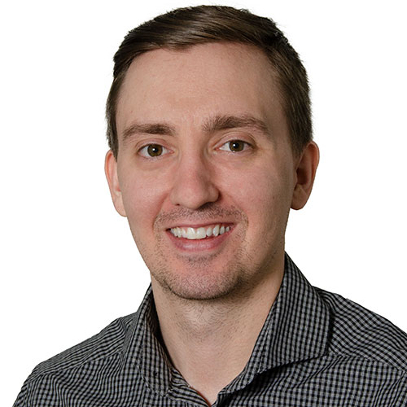
New Animated Video
New Spokesperson Video
New Website – New Splash Pages
Tori will talk to you more about it
Ryan Newell
Ready…Set…GROW!

Slide 5
New Cost Categories
ELD (last live conference)
E-Signature
Utilities
Fuel
Greg and Tim will talk about what’s coming next
Ready…Set…GROW!

Slide 6
Repeat
“If one person can succeed at it, it is proof that others can as well…”
– Abraham Lincoln
I believe in my heart that some of you will accept this statement to be a basic truth.
I believe that some of you will increase your lot in life by accepting this basic truth
The Challenge - Find out how others succeeded at it.
Ready…Set…GROW!

Slide 7
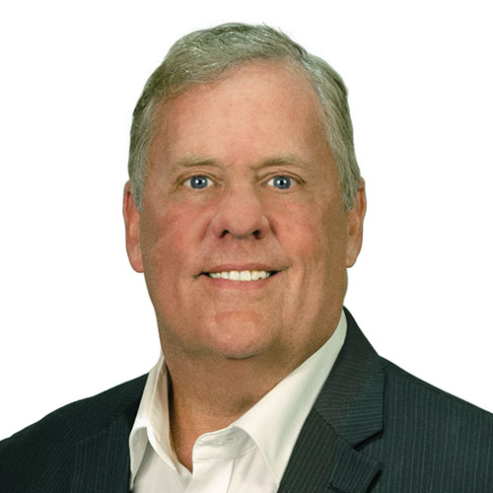
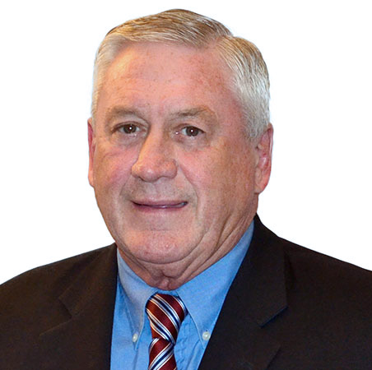
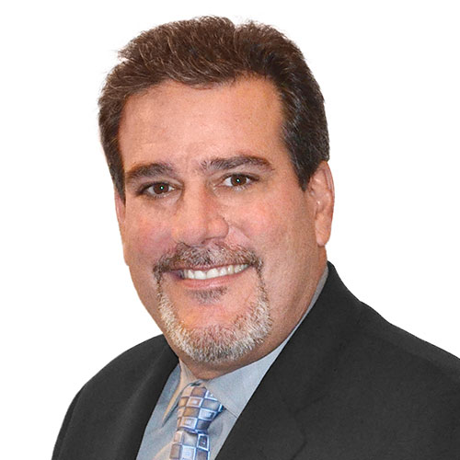
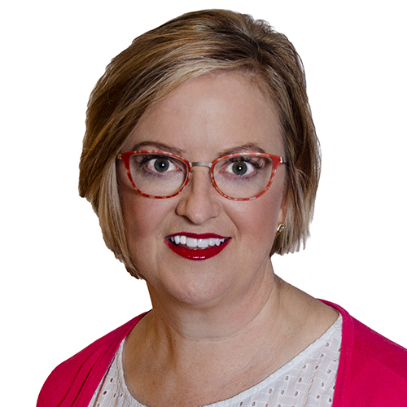
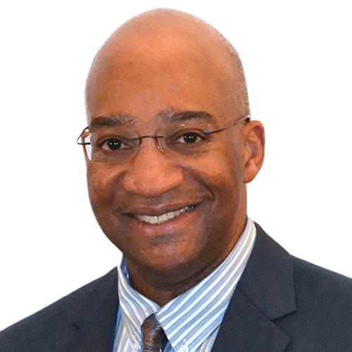
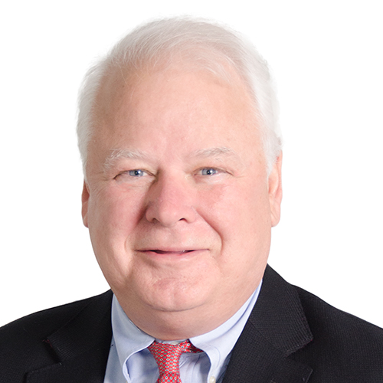
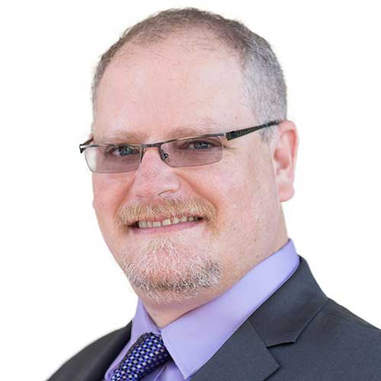
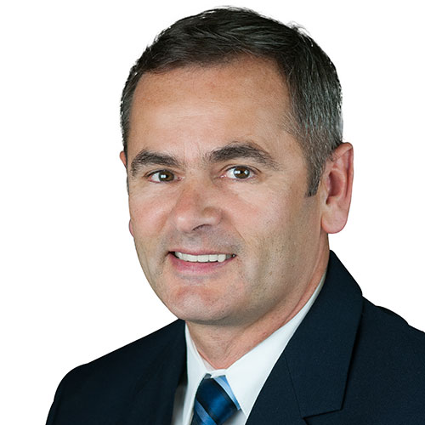
Advisory Council Members
Advisory Council Members
Greg Wisz
John Campbell
Matt Denburg
Jill Lowry
Paul Nelson
Jon Leet
Hernán Popper
William McKissock
One More Year
One More Year
Ready…Set…GROW!

Slide 8
Our Theme – Ready, Set, Grow
We will concentrate on the skills and practices that help you to be ready to pursue opportunities, to get things set and prepared, and to ultimately grow your business and your success
Ready…Set…GROW!

Slide 9
Repeat - Fable
Frank went to a telemarketing appointment and found out that the prospect had lied and had very little spending in any of our categories. Frank was mad because he had driven 30 minutes to get there so he went home and wrote a nasty email about wasted time and poor quality to the person that set the appointment. He had a beer.
Frank felt badly about losing his temper and vowed not to do that again because he knew everyone was trying hard to help.
Ready…Set…GROW!

Slide 10
Frank’s next appointment turned out to be a small company that had not been clear with the caller about expenses.
However, this time Frank set up a coffee meeting with an accountant in the area an hour before the scheduled meeting. He also set up a coffee meeting with a consultant in the area an hour after the meeting. (He ended up liking the accountant but not the consultant so much)
Frank took a half-dozen muffins with him for the prospect and staff.
Frank also left time before the briefing to drive around the neighborhood of the prospect and saw that there was a good-sized HVAC company across the parking lot from the prospect. It turns out that when Frank asked, the prospect knew the controller well.
Ready…Set…GROW!

Slide 11
Instead of walking out of the meeting with the prospect, Frank offered to do the analysis and just see what could be found. He didn’t think there would be savings but said it’s worth a look.
During his conversation he asked about vendors to the business and found out that one of their main suppliers was a significant distributor of steel products and they were just 20 minutes away from the prospect. The owner was a good friend of the prospect.
It also turns out that the prospect only had about 15 customers, but they were all in a specialized industry that used the prospect’s products to enhance their own products before they distributed them across the country in various markets. All of the prospect’s customers had multiple locations and significant sales forces.
Ready…Set…GROW!

Slide 12
Frank was very happy with the conversation with the prospect and continued to discover that he was the men’s champion at the local country club and knew everyone at the club very well.
He also found out that the prospect’s brother-in-law was the CFO at the largest plumbing supply business in the entire county, servicing over 200 individual plumbing businesses throughout the state.
As he was getting set to leave, he asked the client who their IT vendor was and was given a name of a company that he would certainly call for lunch.
As Frank walked out to his car he thought – what great day! And I’m not done yet!
Ready…Set…GROW!

Slide 13
Moral of the Story
Let’s be frank.
Frank # 2 that is!
Ready…Set…GROW!

Slide 14

Movember
Amanda – please be generous.
It’s for men’s cancer.
Ready…Set…GROW!

Slide 15
How much dirt is in a hole that is 3 feet wide, 5 feet long, and 4 feet deep?
Ready…Set…GROW!

Slide 16
None – it’s a hole.
Ready…Set…GROW!

Slide 17
Before Mount Everest was discovered, what was the highest mountain in the world?
Ready…Set…GROW!

Slide 18
Mount Everest.
Ready…Set…GROW!

Slide 19

What color are the circles in this photo?
Ready…Set…GROW!

Slide 20
Most people see four colours (English vs. American) but they are all the same.
Ready…Set…GROW!

Slide 21

There are a total of 12 black dots in this image, but you can't see them all at once.
Ready…Set…GROW!

Slide 22
Great stuff coming this week…
New prospecting ideas and tools
New revenue opportunities
New Warehouse capabilities
Ready…Set…GROW!

Slide 23

Thank you!

