Slide 1

Sales Webinar
Dennis Schooley

Slide 2


Positioning Against ERA
We have chosen to master each of our categories and have established teams of experts at our R&D Center
If we breakdown Telecom, we actually have 18 categories
We will perform monthly post audits to look for new opportunities and to manage your expenses
Ready…Set…GROW!

Slide 3
Community Vendors
These are people you buy from/interact with in your town
These are referral sources. Think of recruiting them as ultimate referral sources
Think of them that way – not as clients – that’s a bonus
Employ the Shining Star strategy – they all have:
1) Neighbors
2) Vendors
3) Customers/Clients
4) Social & recreational business contacts
5) Personal business contacts – friends, neighbors, relatives
Ask them specifically about each
Ready…Set…GROW!

Slide 4
Community Vendors
Example – 20 Community Vendors
Assume – On Average Each Refers:
2 Neighbors
5 Vendors
3 Customers/Clients
2 Social/Recreation Business Buddies
2 Personal Contact Business Buddies
14
280 Referrals!
You just became a millionaire.
Ready…Set…GROW!

Slide 5
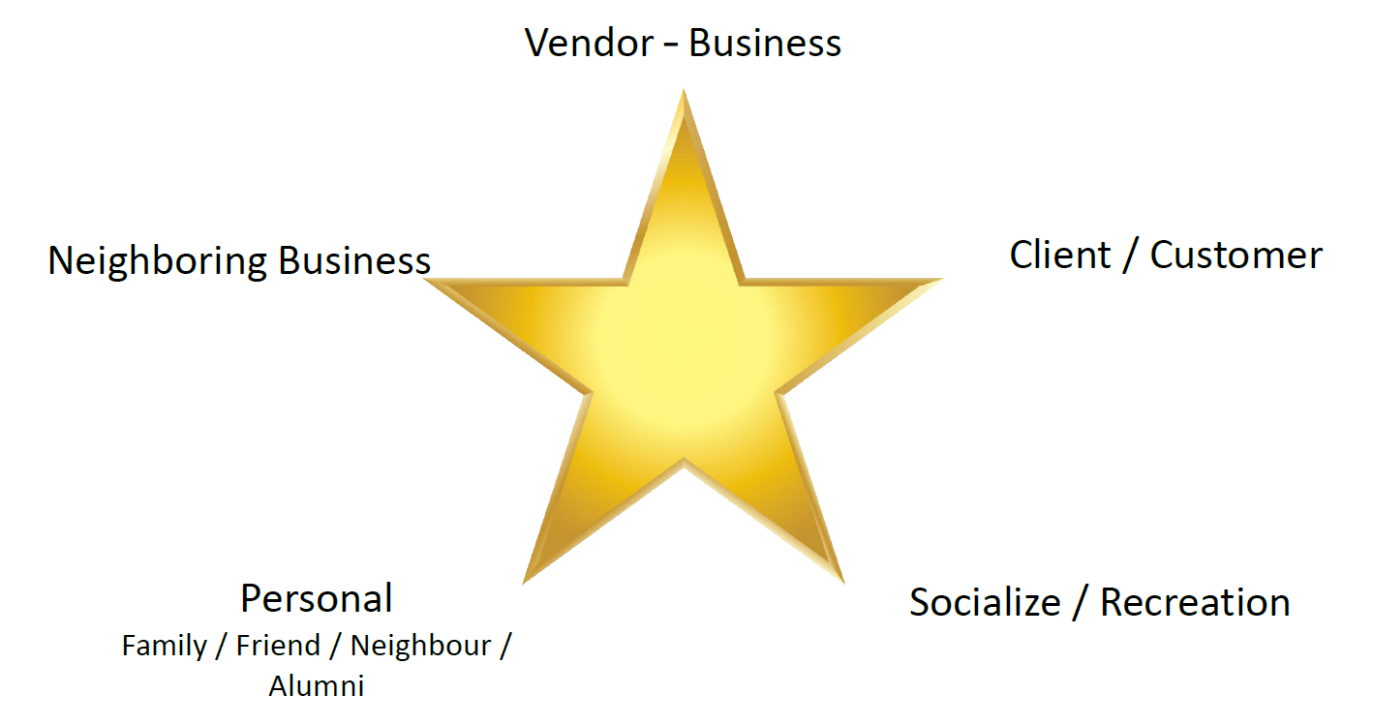
Shining Star
Ready…Set…GROW!

Slide 6
Use the client management sheet.
For every client – not just selected ones
For every step of SMARRT Program – not just selected ones
You do not know which client will refer you to the next big opportunity
You do not know which step influences that target person
You do not know which IT vendor will be the one that refers to you multiple times
You do not know which accounting firm will be the one to reach out
Ready…Set…GROW!

Slide 7
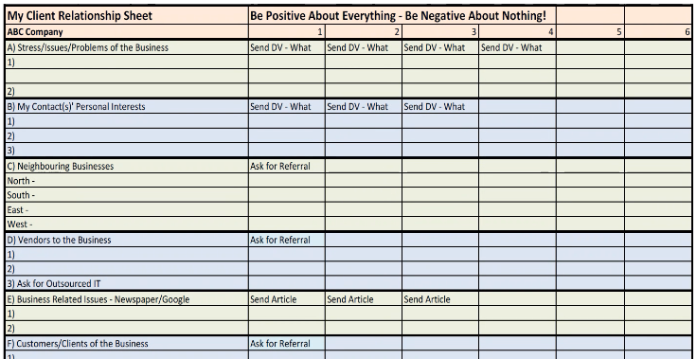
Use the client management sheet.
Ready…Set…GROW!

Slide 8
Coffee Meetings
This is not everyone you meet for coffee
This is a specific strategy – call other professionals you do not know and meet them for coffee
Two per week – GOAL!
Must review the video and PowerPoint – Academy/Resource Centre/ Sales & Marketing/ Meeting Professionals
Give them extra value
1) Give them the unbranded Pulse to send to all their clients
2) Give unbranded Drip Marketing programs to send to clients
3) SMARRT steps for them
4) DV for them
Ready…Set…GROW!

Slide 9
Paid Referrals
You must work on these relationships – EVERY WEEK
Lunch/coffee – collaborate with them about perfect targets for you that they may know
Ask them what business people they know and deal with regularly
The more you make them familiar with what you are seeking – the more they will be able to refer to you
Back and forth over time, back and forth, back and forth – don’t bug them but stay in their face
What’s worse – being ignored or told no – they are both equal to no – ignored just takes longer and drags out the pain
So let’s go for the yes – and pile up the no’s to get there!
Ready…Set…GROW!

Slide 10
Why I Don’t Ask
Fear of ‘no’
Embarrassed
No value yet
Not enough value yet
I’m waiting until I see them
Excuses
Ready…Set…GROW!

Slide 11
Why They Don’t Refer
They ignored my referral
They bugged my referral
Might make me look bad
I don’t have time for this
Ready…Set…GROW!

Slide 12
Use the Drip Marketing Section for Paid Referrals
Great Stories about other successes
Use the communication system in The Warehouse
Ready…Set…GROW!

Slide 13
Claim Professionalism
With gusto and pride
It’s not just you
SM -> Tools / Clout / Experience / Clients
Proper conversation
  Professional growth
  Not under-the-table
  Mutual benefit
    Client
    Source
    SM
Use SMARRT -> Value Immediately
Ready…Set…GROW!

Slide 14
BNI Specific Ask
You must set a goal for yourself – 2 per week for the meeting and 2 per week for 1-2-1 lunch
What is it?
Identify a business that you would like to have as a client that you know is a neighbor/vendor/customer/contact of someone in BNI
How?
Google – person and business, LinkedIn, Facebook, Twitter, Google Places, Instagram
Drive By!
Their website
Do the leg work – stalk them!
Ready…Set…GROW!

Slide 15
And my feature prospect for the week is…
Jones Plumbing Supply
Ready…Set…GROW!

Slide 16
$5 Presentation
Review the video several times – learn it cold
Claim hokey! It doesn’t matter
Get them to focus – that’s the key
Get them to write down a neighbor/vendor/customer – take the paper and pens with you
Or use their phone
Ready…Set…GROW!

Slide 17
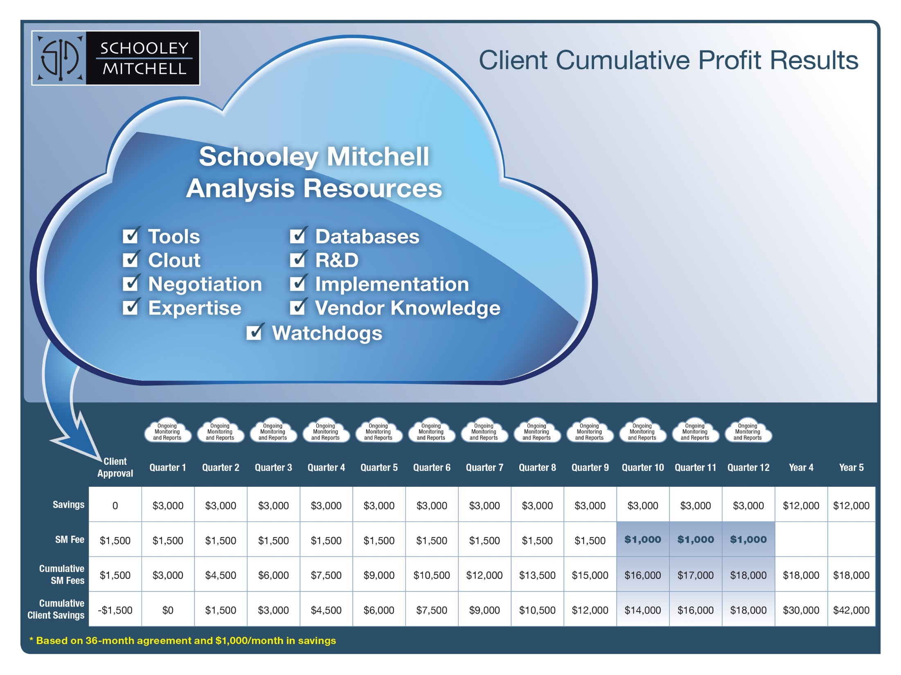
Ready…Set…GROW!

Slide 18

Thank you!

