Slide 1

Value Report Presentation Best Practices
Mick Wienholt

Slide 2


When you get VR from Analyst
Review the VR to ensure you fully understand the recommendation
Discuss the VR with the analyst to ensure you have a planned message and a plan to deliver that message
You are selling your recommendation
Do NOT let the figures sell themselves as nothing sells itself
When settled on the VR content and message set the meeting with the client
Ready…Set…GROW!

Slide 3
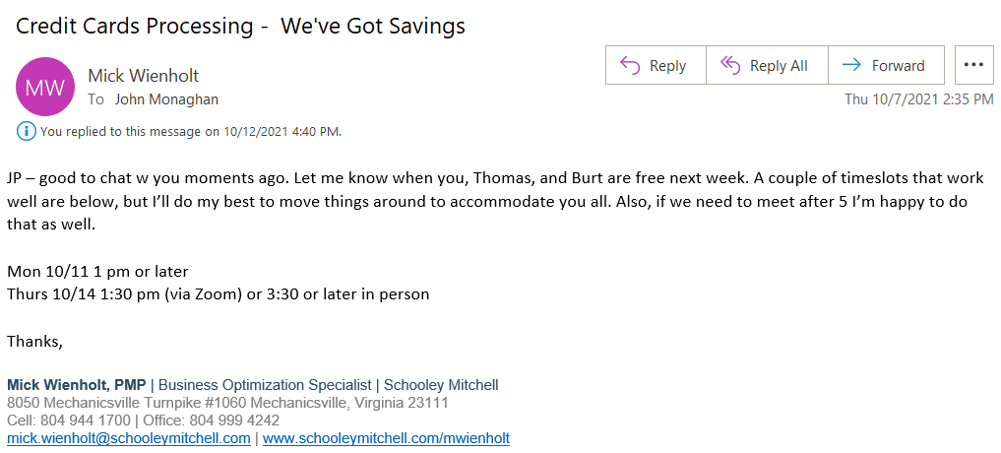
Set Stage with the Client to Get the VR Meeting
Send email or call client to explain that there is savings. Do NOT indicate the extent of the savings.
In the example below you can see that I spoke with the client then sent a follow up email to set the meeting.
Ready…Set…GROW!

Slide 4
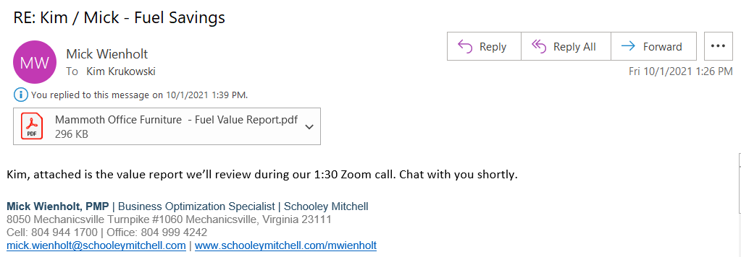
Prior to the VR Review – Zoom Meeting
Send the VR 5 minutes before the meeting
You want the client to receive it moments before the meeting so that they can’t review it in detail, as that diminishes your value… you need to walk them through it
Client receiving it in advance shows you aren’t hiding anything
Client receiving it in advance is a reminder to attend the meeting
Ready…Set…GROW!

Slide 5
Prior to the VR Review – In Person Meeting
Have copies of the VR for all potential attendees
Highlight the areas that you wish to cover specifically (either for you or in the VR you’ll give the client)
Ready…Set…GROW!

Slide 6
VR Review – During Meeting
1
Set agenda:
Review the savings
Answer your questions
Discuss next steps
Ready…Set…GROW!

Slide 7
VR Review – During Meeting
2
Remind them of the realities:
My recommendations are what I believe to be in your best interest
I’m not compensated by any vendor
All decisions are yours
Ready…Set…GROW!

Slide 8
VR Review – During Meeting
3
Explain the process:
Briefly review the savings
Review your current state
Discuss our recommendation
Look at options
Discuss next steps
Ready…Set…GROW!

Slide 9
Start Walking Client Through Content
If via Zoom, have up on screenshare (you drive, they don’t)
If in person, direct them to page 3
Highlight savings amounts on page 3
Emphasize % when dollar amount is small
Emphasize $ when % is small
Emphasize both when both are big
If the savings is a rerate indicate at this point that the savings does not require a vendor change
Ready…Set…GROW!

Slide 10
Move to Current Configuration
Explain that we’re going to review what you currently have and then discuss our recommendation
Highlight current costs
Highlight key points such as early term fee (ETF), contract term, contract end date, etc.
Ready…Set…GROW!

Slide 11
Do NOT read the document, instead speak to the content
Check for accuracy: “All of your current configuration is based on the data, invoices, and contracts so we know it’s accurate. That said, to the best of your knowledge does it look like what you believe to be your current state?”
You are wanting them to tell you that you’re correct, which affirms your level of expertise
Ready…Set…GROW!

Slide 12
Move to Option A
Explain the main elements of Option A as they relate to the main elements of the Current Configuration
Highlight new costs and key points such as early term fee (ETF), contract term, contract end date, etc.
Do NOT read the document, instead speak to the content
Ready…Set…GROW!

Slide 13
Move to Option A
Check for understanding: “Option A is our best recommendation. I want to ensure you have what you need to make an informed decision and to understand this option compared to the other options, which I’ll show you in a moment. Before we move on to Option B, what questions do you have?
You are wanting the client to put any questions, concerns, objections on the table now
Ready…Set…GROW!

Slide 14
Move to Option B
Explain how Option B fits into the mix by providing context
Example: Option A is the greatest amount of savings, but its with a national card processor. Here in Option B the savings is slightly lower, but the processor is local to you.
Explain the main elements of Option B as they relate to the main elements of the Current Configuration
Ready…Set…GROW!

Slide 15
Move to Option B
Highlight new costs and key points such as early term fee (ETF), contract term, contract end date, etc.
Do NOT read the document, instead speak to the content
Check for understanding: “What questions do you have?
You are wanting the client to put any questions, concerns, objections on the table now
Ready…Set…GROW!

Slide 16
Move to Option C
Explain how Option C fits into the mix by providing context
Example: Option C is what the rest of the market wants you to pay. It’s not really our recommendation because the pricing is far out of line with Options A and B, but as we’ve discussed, we don’t have a horse in the race other than you so I want you to see what the market looks like if you negotiated on your own.
Ready…Set…GROW!

Slide 17
Move to Option C
Explain the main elements of Option C as they relate to the main elements of the Current Configuration
Highlight new costs and key points such as early term fee (ETF), contract term, contract end date, etc.
Ready…Set…GROW!

Slide 18
Move to Option C
Do NOT read the document, instead speak to the content
Check for understanding: “What questions do you have?
You are wanting the client to put any questions, concerns, objections on the table now
Ready…Set…GROW!

Slide 19
VR Review – Closing the Meeting
Move to Close
Now that all options are reviewed come back to the option that you believe to be the one the client is most interested in and check in:
“What questions do you have about Option ___?”
Ready…Set…GROW!

Slide 20
VR Review – Closing the Meeting
Explain Next Steps:
In order for us to get moving on Option ___ for you, we need your signature on page 3. This will allow us to get the contract over to you from ___________ (vendor). You’ll then review and sign their contract and we’ll manage the implementation for you.
Ready…Set…GROW!

Slide 21
VR Review – Closing the Meeting
Ask them to sign page 3
Give them a pen and have them sign
Zoom: ask them to sign, scan, and send to you
Explain next steps
Now that we’re all set, I’ll get the contract over to you, you get it back to me, and then we’ll be off to the races for you.
Thank them and move along
Ready…Set…GROW!

Slide 22
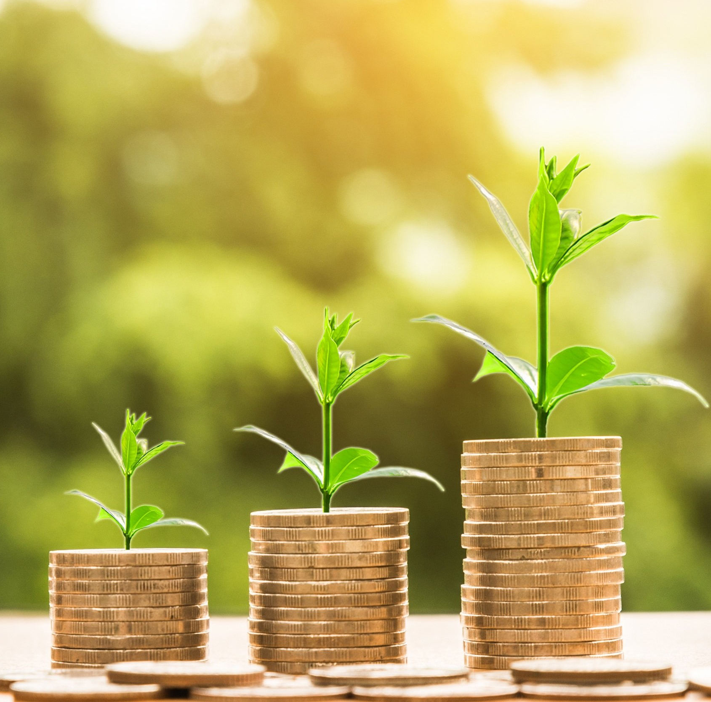
Thank you!

