Slide 1

Communications and Marketing
Tori Sutton

Slide 2


Overview
1. Year in Review
2. Online Store
3. Communications Refresher, Reminders, and FAQ
4. LinkedIn
Ready…Set…GROW!

Slide 3


Year in Review
Team Growth
Ready…Set…GROW!

Slide 4
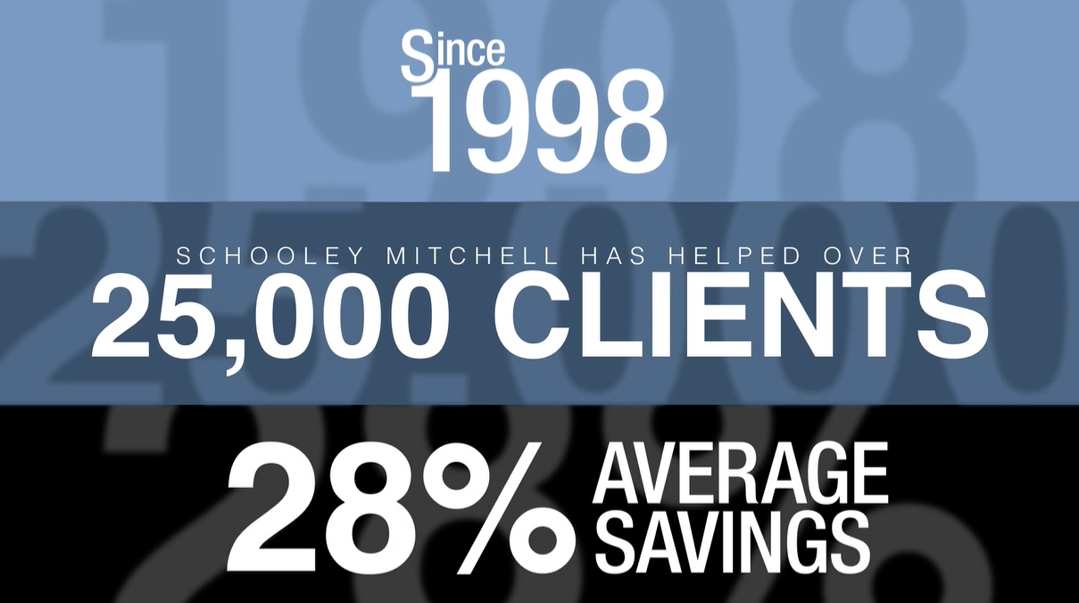


New Assets
Ryan’s rework of the animated video is top notch – succinct and modern.
Ready…Set…GROW!

Slide 5
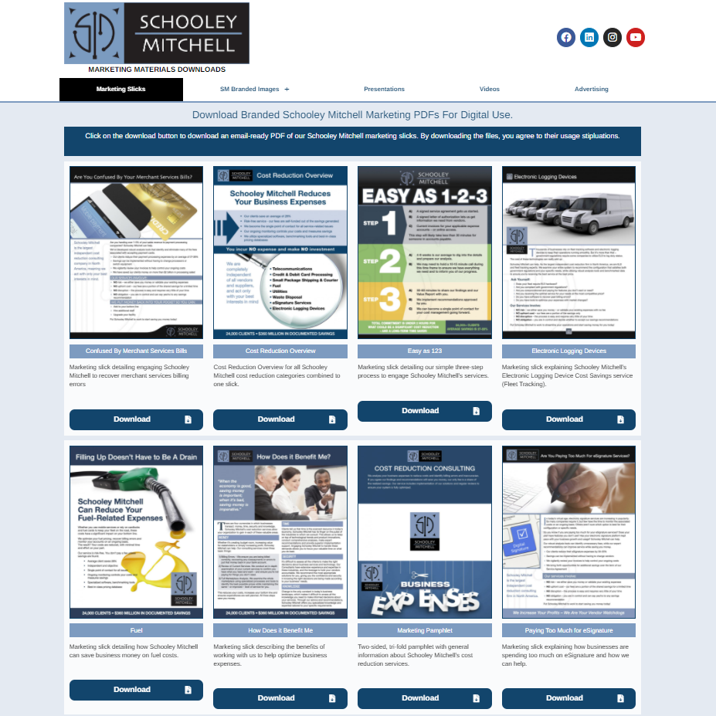
Marketing Download Site
This allows you access materials without the need to submit a support request
SELF CHECKOUT
Now linked under the “Libraries” tab within the Warehouse
Ready…Set…GROW!

Slide 6
Marketing Download Site
Has the following:
Copies of our marketing one-pagers – these are for digital use only
Branded images – broken down into platform
Presentations – contains PowerPoint templates
Videos – can download our videos from here
Advertising – current advertising templates – review before support request
Will be adding to this over time – expect more material and features
Ready…Set…GROW!

Slide 7
New Website
Great feedback – thank you all for that
Just the start, we envision even better things to come
Analytic data is just starting to roll in – page views up 12%
Have noticed an increase in contact form submissions – both Head Office and zee pages
Ready…Set…GROW!

Slide 8
New Website
New splash page features:
Better organization of essential content – easier for the user to find exactly what they need while still providing relationship capital by promoting others, community involvement, etc.
Looks and feels more like a standalone website than old pages – captures traffic, doesn’t encourage users to navigate to other areas of the website as easily
Overall, we feel the aesthetic is much more representative of our brand
Ready…Set…GROW!

Slide 9
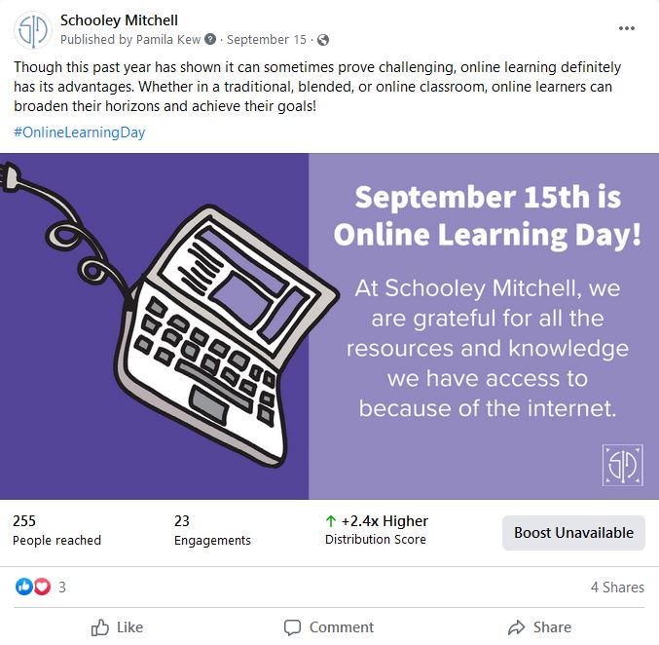
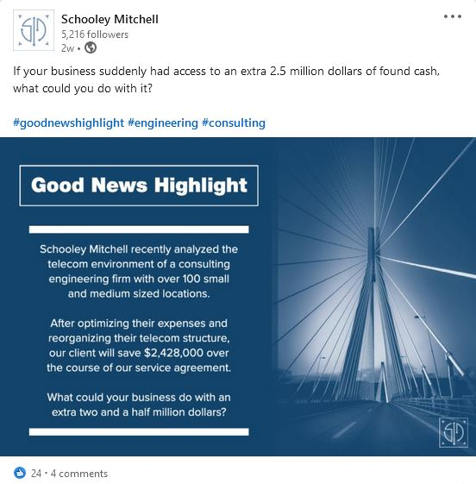
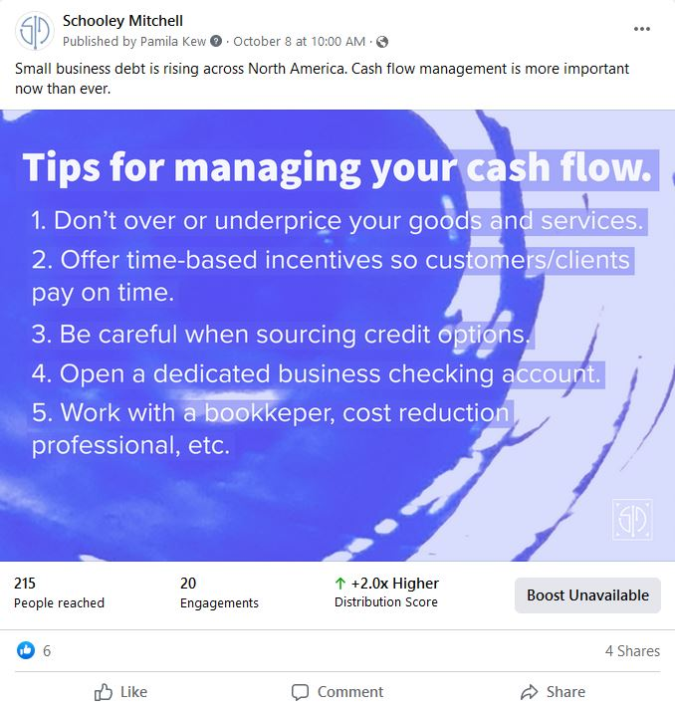
New Corporate Social Strategy
May have noticed a change in the frequency and type of posts to our corporate channels
Dedicated content for each channel, cohesive
Still a work in progress and will continue to evolve
Ready…Set…GROW!

Slide 10
Refreshed Blog and Pulse
Stronger editorial focus: relevant material to establish thought leadership
Blog subjects position us as the experts; Pulse is a great value add
Multi-part blog series have been especially popular
Plenty of positive feedback re: quality of content
Special thanks to Christine Wilson
Ready…Set…GROW!

Slide 11
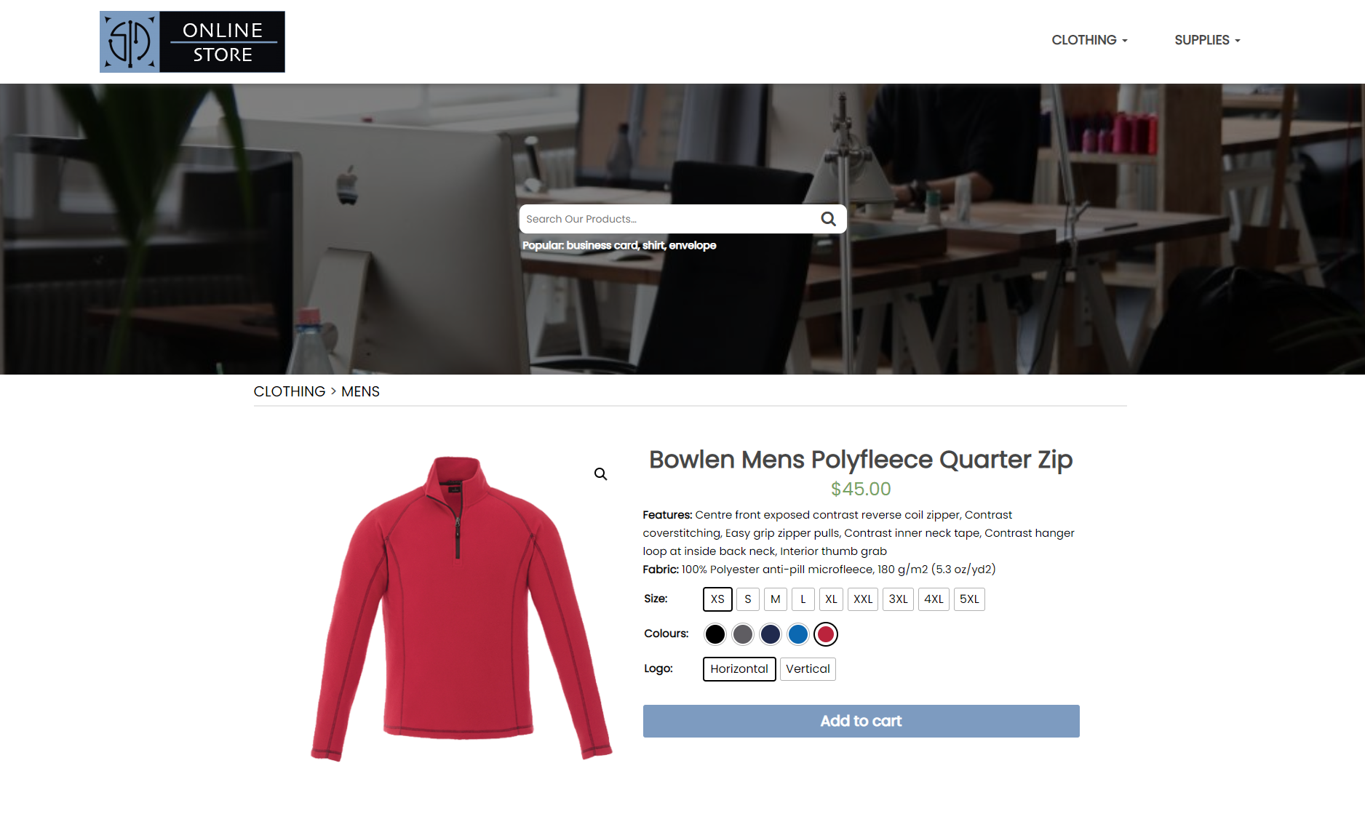
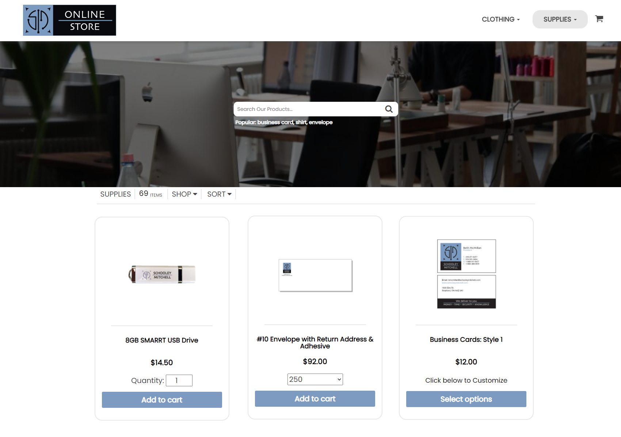
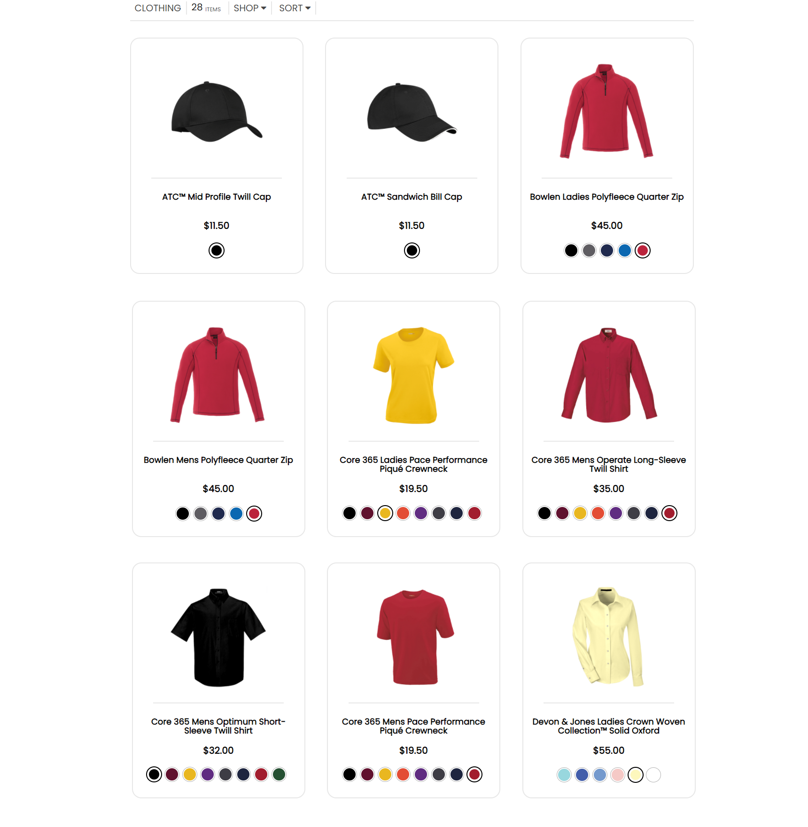
Launch - Updated Online Store
Ready…Set…GROW!

Slide 12
Launch - Updated Online Store
Great work by website administrator Ian Nairn
This was one of the very first in-house programming projects many years ago; back then, online shopping wasn’t really a thing
Replicates the online shopping experience we are all accustomed to
Searchable and easy to navigate
Ready…Set…GROW!

Slide 13
Launch - Updated Online Store
Browse clothing and supplies, can even see clothing in different colours
Previous store was Franchisee-only access – we’ve listened to your feedback. New store will allow subcontractors and employees to browse, but not purchase
Payment will still be handled via PAD
It’s live now – please let us know if you run into any issues
Ready…Set…GROW!

Slide 14
Google My Business
Continues to be one of the most important listings on the web, and also the most sensitive for us
We set this up for you – we manage this for you – please DO NOT create your own, please follow any instructions given to you by our team
If in doubt, ASK first
Friendly reminder that we do not give access to these listings due to their sensitive nature
Ready…Set…GROW!

Slide 15
Google My Business
9/10 consumers read reviews before making a purchase (Trustpilot, 2020)
Not just B2C – 92% of B2B buyers are more likely to make a purchase after reading a trusted review (G2 Group/Heinz Marketing)
Huge credibility boost for your business – FREE advertising on the first page of Google – 79% of respondents say they trust online reviews as much as personal recommendations (BrightLocal, 2020)
Ready…Set…GROW!

Slide 16
Google My Business
Easy avenue to obtain testimonials that can be used across your business (think one-pager with some client logos and quotes from your Google Reviews)
You have to go for the ask – very few people will leave us reviews as readily as they might for a restaurant or retail store
Utilize the link we set up for you. Forget your link? Support request.
Make it as easy for them as possible!
Ready…Set…GROW!

Slide 17
Third-party Marketing Engagements
Friendly reminder that any and all third-party marketing engagements need to be approved before you proceed
All email has to be sent through authorized servers – this can directly impact automated email software, external CRMs, etc.
No external access to our website, your splash page or social media (agency access permitted for authorized campaigns)
Always reach out before you sign up or commit funds
Ready…Set…GROW!

Slide 18
Psst… Tori… What is SEO?
SEO = Search Engine Optimization
Search engines compile a wide variety of data, use it to index and rank pages
Provides relevant, authoritative content, improves user experience
Takes MANY things into account – more than we can list…
Content, architecture, HTML, reputation, links, user experience
SEO is important, but not the be-all and end-all; we offer a service many do not know exist, therefore, aren’t searching for it
Ready…Set…GROW!

Slide 19
Should I utilize email attachments in cold reachouts?
Pros:
Can save content and review later
Makes it easy to share with others outside the initial email
Don’t have to fiddle with HTML email
Saves a step, if they do end up wanting the content
Ready…Set…GROW!

Slide 20
Should I utilize email attachments in cold reachouts?
Cons:
Can harm email deliverability, especially B2B; many businesses have increased security, will get quarantined or go to spam
Extra click for recipient to get to the real information
Not mobile device friendly – many people do not want to download files to their phones or tablets
When was the last time you opened an attachment in a cold email from a complete stranger?
Ready…Set…GROW!

Slide 21
Should I utilize email attachments in cold reachouts?
Think about your goals: This is not a transactional email, it’s a marketing email – you want to start a business conversation and get a response
You need to pique the recipient’s interest, gain their trust, and then they will open an attachment – not the other way around
If you are going to attach a PDF:
Reference the attachment in the email body
Ensure the file size is appropriate
Be mindful of security
The fewer, the better
Ready…Set…GROW!

Slide 22
Should I utilize email attachments in cold reachouts?
What’s the alternative?
Host file online and include link in your email – so they can open/view in browser without the need to download
Landing page – we can help with this
Ask first, then deliver
Ready…Set…GROW!

Slide 23
How do I get people to read my cold emails?
Cold emailing is a strategy that should be undertaken mindfully – we strongly discourage bulk emailing – ensure you are abiding by anti-spam legislation in your respective country
Must have a strategy; define goals, segment audiences, identify decisionmakers, do your homework (Jess and Lori are going to talk about this on Wednesday)
Ready…Set…GROW!

Slide 24
How do I get people to read my cold emails?
Average open rates for B2B emails is typically between 17-20% (Mailchimp, Constant Contact)
Pandemic increased the number of cold emails being sent – need to catch attention and deliver value
Needs to be actionable – always include a CTA (call to action)
Would it make sense to schedule a call? I’m available …. (times); We just published a post about this, check it out here; Could you share this with your team and get back to me?
Ready…Set…GROW!

Slide 25
What are the best email subject lines?
Questions are enticing, figures add authority, personalization is a thing
Keep it short, keep it simple – 50 characters or less preferred – avoid special characters and spammy words
A/B test
Create familiarity – makes you human – consider connecting on LinkedIn etc. before sending the email
Ready…Set…GROW!

Slide 26
What are the best email subject lines?
Personalized: Joe, got a second?; We heard you are an expert, Jessica; Could Smith Distributing use a helping hand?
Minimalist: I’m impressed, Greg (good for new role or achievement); Let’s get real
Question: Ask a tailored, relevant question – this needs to be segmented to be truly effective
Follow up: Don’t worry, we’re busy too; I knew I was forgetting something; Let’s try this again
Ready…Set…GROW!

Slide 27
What are the best email subject lines?
Direct benefit: How to reduce expenses by 28%
Proof-driven: How a construction company saved $253,403; $253,403 in 3 months; Here’s what Jackson Hospital’s CEO said about us (email based on case study/testimonial)
Urgency/Scarcity/Timeliness: Usually contingent on an event in B2C, think outside the box based on segmentation for B2B
End of quarter, major industry changes (new legislation, transitioning to new technologies)
DON’T LIE
Ready…Set…GROW!

Slide 28
What content goes on what platform?
LinkedIn – jobs/career info, company news, professional content
Content should be relevant to professionals in your target audience. Examples include:
Industry news and stats
Training webinars
Whitepapers
There is room for personality, though the vast majority of content should be directly related to business
Images and videos perform well on LinkedIn; native upload or YouTube links
Review LinkedIn content suggestions in Sales & Marketing library
Ready…Set…GROW!

Slide 29
What content goes on what platform?
Instagram – photos, quotes, stories, reels
Photos – always high quality
Product photos (in our case, businesses/clients we feature)
Behind-the-scenes, when relevant or interesting
Quotes
Keep relevant to our business, cost reduction strategies, financial literacy
Seek out the best quotes that support your brand mission
Use your own images where possible
Don’t go overboard
Stories and Reels
Story telling, tutorials, promoting a blog, sharing a list, announce events, share data, research or statistics, engage via polls, questions, etc.
Ready…Set…GROW!

Slide 30
What content goes on what platform?
Facebook
Videos have the highest engagement, how-tos / educational videos perform well
Summaries/link-shares of blog posts (think quick summary of blog post in video form!)
Curated content via third party can be selected to suit your audience
Educational and entertaining (just like me!)
Ready…Set…GROW!

Slide 31
What content goes on what platform?
Twitter – sharing info and opinions
Twitter is more pop-culture/politics centric than other platforms
Real-time, must check in regularly to use effectively
Ready…Set…GROW!

Slide 32
LinkedIn – News and Best Practices
Cover Story – 30 second video! Must be uploaded and edited via mobile app
Can only see orange frame around the profile photo if you are using this feature yourself
Creator Mode – Not the best fit for those wanting to expand their network
Changes your Connect button to Follow
Intro card displays your number of followers, featured hashtags
Ready…Set…GROW!

Slide 33
LinkedIn – News and Best Practices
LinkedIn Audio Rooms
Feature currently under development
Appears to be similar to Clubhouse
Open to Work and Hiring Frames
Open to Work – potential referral sources?
Hiring – is the company expanding?
Ready…Set…GROW!

Slide 34
LinkedIn – News and Best Practices
Connection Request Limits
Set to 100 a week in an attempt to limit spam and automation
Users have been reporting this cap across free and paid accounts
The algorithm is a LinkedIn trade secret, but many recommend having no more than 700 pending connection requests in your queue
If you slow start sending Connection requests, LI may let you add more than 100 per week; however, if not many people are accepting or replying, it could trigger the limit faster
The more you spam, the greater the punishment
Ready…Set…GROW!

Slide 35
LinkedIn – What you should be doing.
Dedicating minimum of 15 minutes per day
Not spending more than an hour without a plan
Customizing every connection request, and responding to every one you receive
Ready…Set…GROW!

Slide 36
LinkedIn – What you should be doing.
Posting 2-3x per week, but no more than 30 times per month
Striking while the iron is hot; immediately respond to any engagement that occurs within two hours of posting – LI algorithm favors this
Avoid automation, or approach carefully (if you must)
Ready…Set…GROW!

Slide 37
LinkedIn – What you shouldn’t be doing.
Tagging everyone you know in every post
If you consistently tag people who never engage with your content, the LI algorithm will push down your post and make it less visible
Combats people exploiting this feature – tagging prominent people to gain more views
Sharing other’s posts is also suffering from lower visibility, but you should continue this as it’s great relationship building
Ready…Set…GROW!

Slide 38
LinkedIn – What you shouldn’t be doing.
Discussing incendiary/contentious topics
Creating your own images, branded or unbranded
Being lazy
Always going in hot – pushy sales messaging
Not taking the time to personalize
Spamming all your groups with the same messages
Making no effort to nurture relationships, hiding behind a keyboard
Ready…Set…GROW!

Slide 39
LinkedIn groups.
An opportunity to provide value to other professionals, expand your network
Your groups will be listed at the bottom of your LinkedIn profile by default, need to edit the visibility if you do not want them to appear
Best practices
It’s like walking into a conversation – take the time to catch up on topics, observe before jumping in
Contribute first – something of value, not self-promotional, off-topic, etc.
Ask questions to get a conversation started
Ready…Set…GROW!

Slide 40
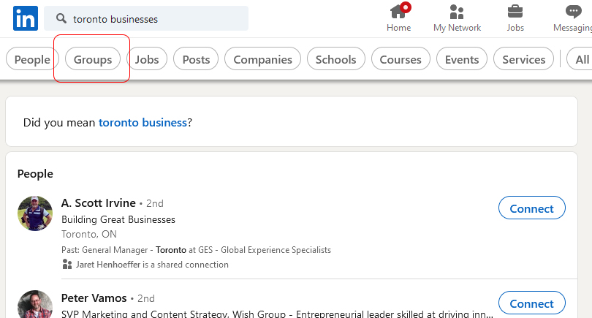
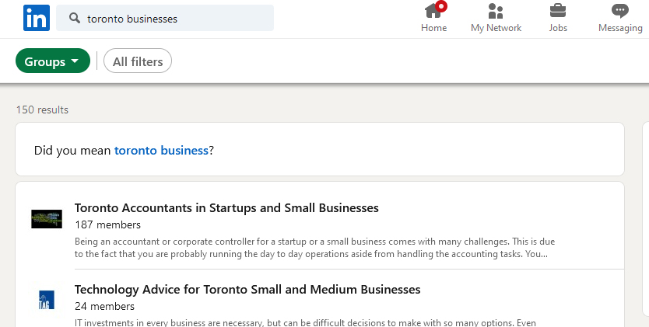
LinkedIn groups.
Ready…Set…GROW!

Slide 41
LinkedIn groups.
Choosing Groups
Not all groups are created equal – some are inactive and/or spammy
Search for groups by using keywords in search bar, then click “Groups”
Suggest searching by geography, by vertical, etc.
You may have to join the group to determine if it’s truly active/a good fit for you
Ready…Set…GROW!

Slide 42
LinkedIn groups.
Consider not only prospects, but referral opportunities as well
Alumni groups can be very fruitful
Unlisted groups are like a secret club – need an invite to join and cannot be searched
Consider building your own group (this takes time)
Ready…Set…GROW!

Slide 43
LinkedIn groups.
Ensure you read the group’s rules carefully, each is moderated individually with its own rules – many will require any promotional content to be submitted via a moderator for approval
You can message other group members, even if you are not connected with them (access member list from group, search for the member, click Message)
Ready…Set…GROW!

Slide 44
Sales Navigator
Free vs Paid?
Free account – start here if you are a newer user
Paid – suggest Sales Navigator level – upgrade when you start to hit the commercial use limits for search
Sales Navigator contains a host of advanced features, monthly InMail credits, unlimited searches, access to LinkedIn Learning
Ready…Set…GROW!

Slide 45
Sales Navigator
Upgraded search filters: changed jobs in past 90 days, mentioned in the news in the past 30 days, posted on LI in the last 90 days, connected to people in your network, leads that follow your company
Now can bookmark posts for easy review later (similar to Facebook and Instagram)
Ready…Set…GROW!

Slide 46
Sales Navigator
Improved account mapping: visual tool that allows you to map account relationships, rearrange leads in tiers
Beneficial for multi-threading, identifying gaps in hierarchy, identifying influencers
Improved Account page is a convenient one-stop-shop for information, such as insights, alerts and relevant company information
Ready…Set…GROW!

Slide 47
Existing LinkedIn resources
Warehouse > Libraries > Sales & Marketing Library > Social Media
Activity, content guides, other tips and tricks
Warehouse > Libraries > Sales & Marketing Library > Webinars
Online prospecting, LinkedIn for Beginners
Warehouse > Annual Conference > Select Year
Have presented information on LinkedIn in 2013, 2016, 2017, 2018, 2019
Slides are there for your review
Ready…Set…GROW!

Slide 48
Your LinkedIn plan.
Workshop materials will be sent out to everyone
Stephanie Sammons approach
Can act as a guide for you to start developing a strategy, segmenting your audience
Will help you build a smarter network and guide your activities
Ready…Set…GROW!

Slide 49
Your LinkedIn plan.
Includes:
Identifying unique market opportunities for connecting with relevant people
Growing your visibility through value
Identifying top connections for 1-2-1 engagement
Smarter networking through providing value
Group strategy and discussion
Thought leadership
Ready…Set…GROW!

Slide 50

Thank you!

