Slide 1


Let’s Talk about Asks
Jessica Thom
Director of Training & Education
Lori Stankiewicz
Franchise Success Advisor

Slide 2



How to ask for Referrals
Use referral templates
Don’t expect immediate results
Build value first, then ask
Ask, “who do you like?”
Don’t treat referrals like cold calls
Offer incentives for referrals
Get specific with your ask
Develop a referral mindset
Stay connected with customers
Focus on your strongest relationship
Ready…Set…GROW!

Slide 3

Are you being SPECIFIC?
Ready…Set…GROW!

Slide 4


Slide 5

“I want to meet anyone who needs my services.”
Ready…Set…GROW!

Slide 6


Ready…Set…GROW!

Slide 7

Key Components of an Ask
Criteria
Location
Industry
Company
Name of Person
Specific Ask
Ready…Set…GROW!

Slide 8

Common Places for ASKS
Networking Pitches
121s
Referral Partners
Clients
Ready…Set…GROW!

Slide 9
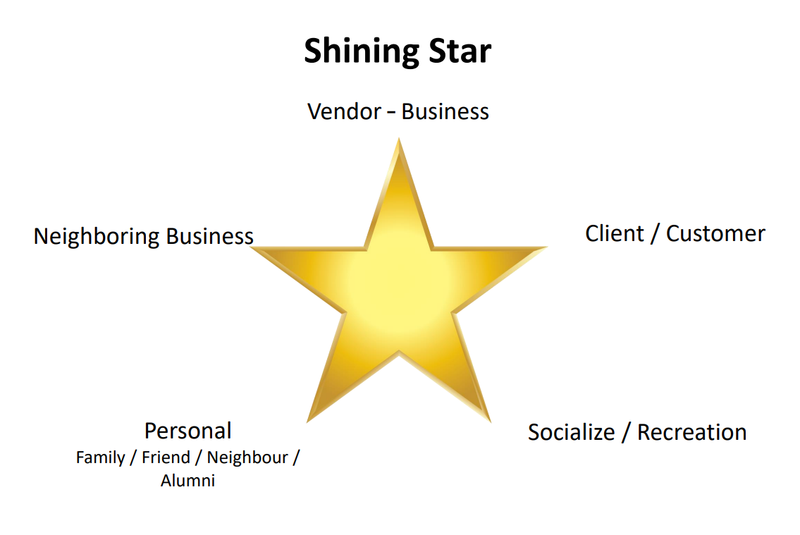
Ready…Set…GROW!

Slide 10

Networking Asks- Research
Google
Google Maps
Company Website
LinkedIn
Facebook
Twitter
Ready…Set…GROW!

Slide 11
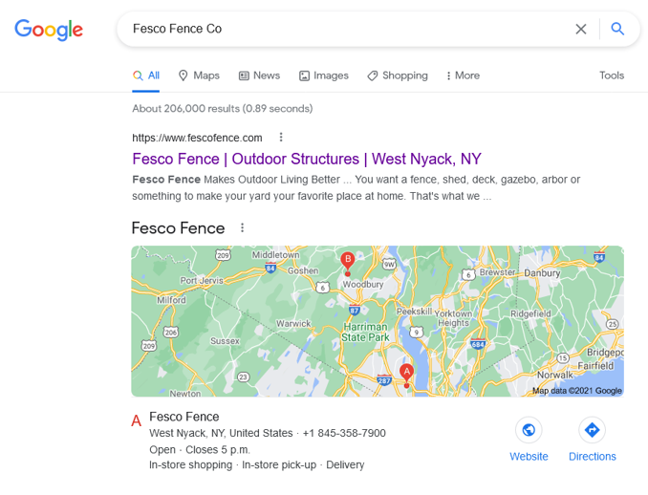
Ready…Set…GROW!

Slide 12
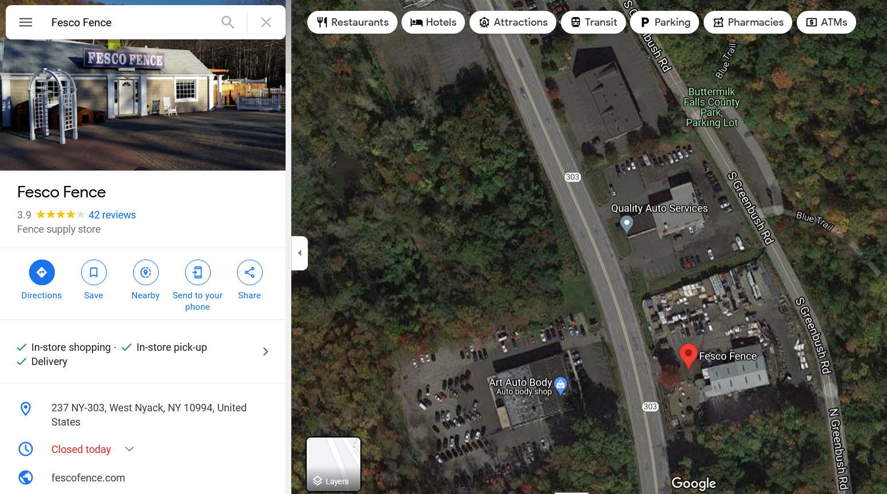


Ready…Set…GROW!

Slide 13
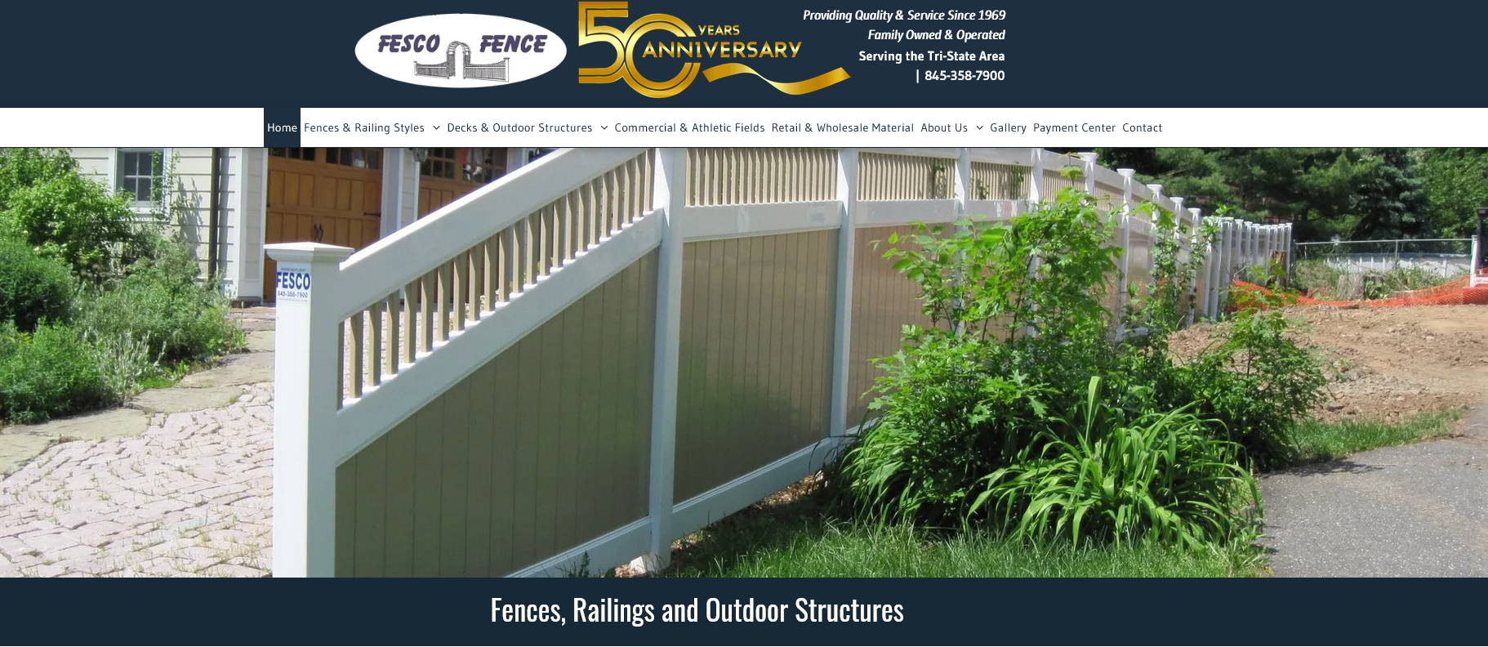
Ready…Set…GROW!

Slide 14
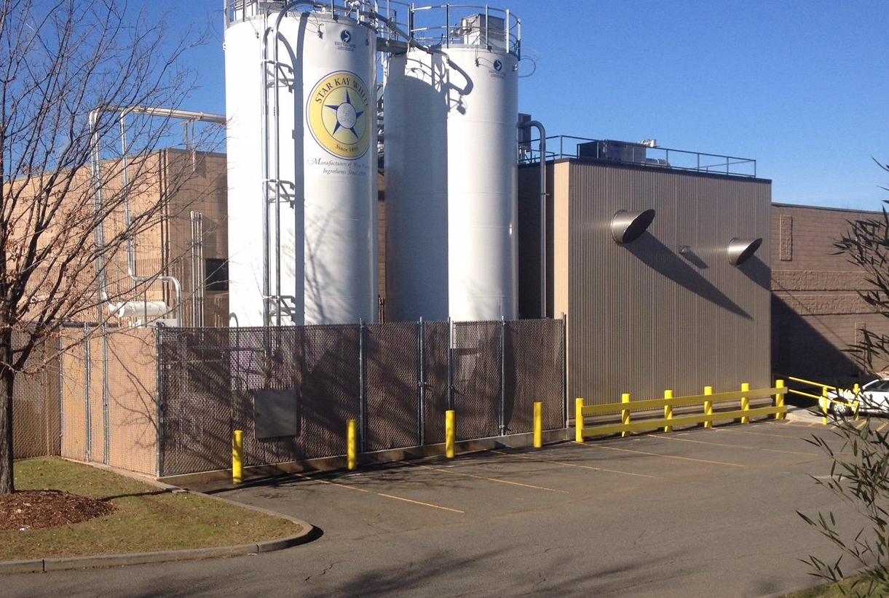
Ready…Set…GROW!

Slide 15
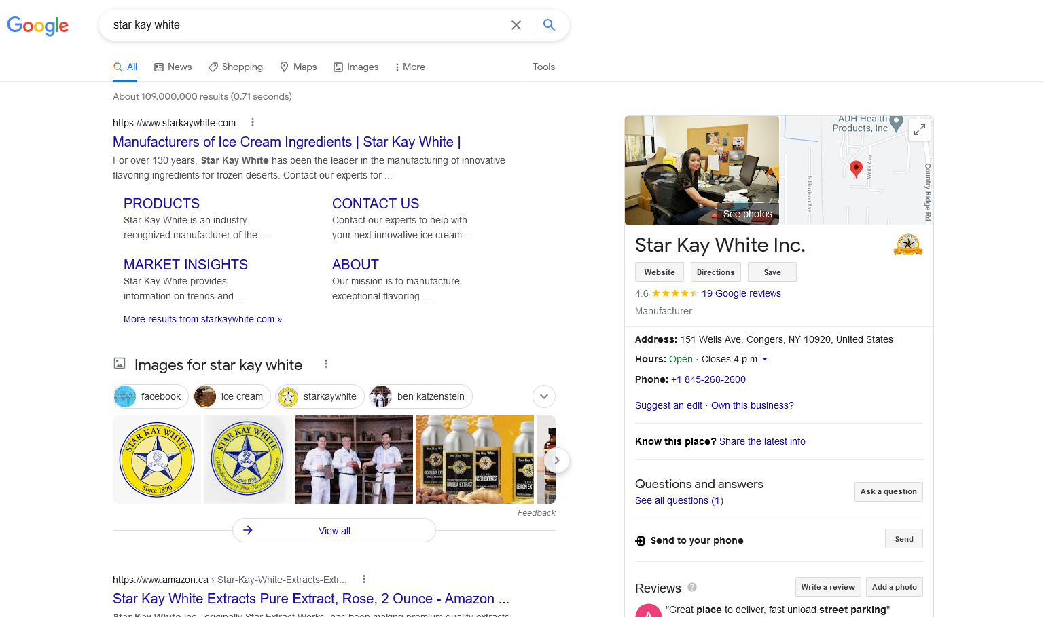


Slide 16
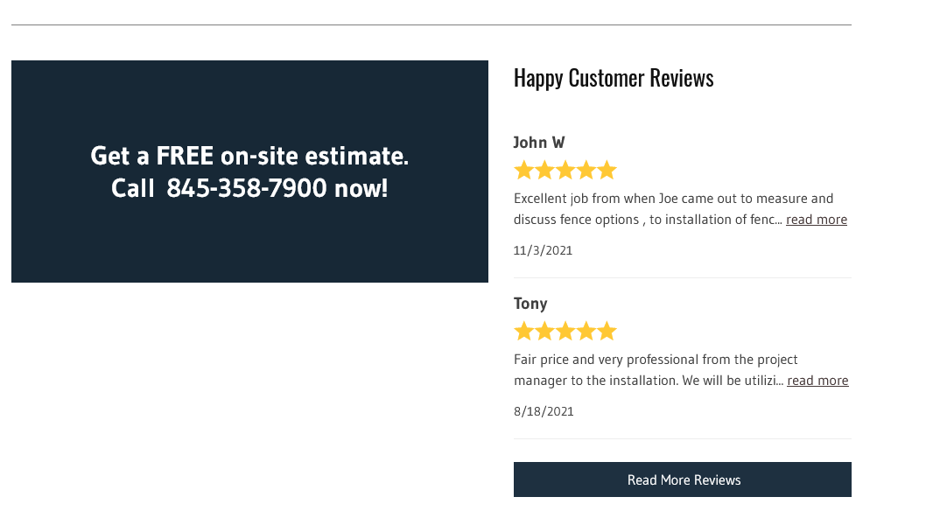
Ready…Set…GROW!

Slide 17

Ready…Set…GROW!

Slide 18


Ready…Set…GROW!

Slide 19
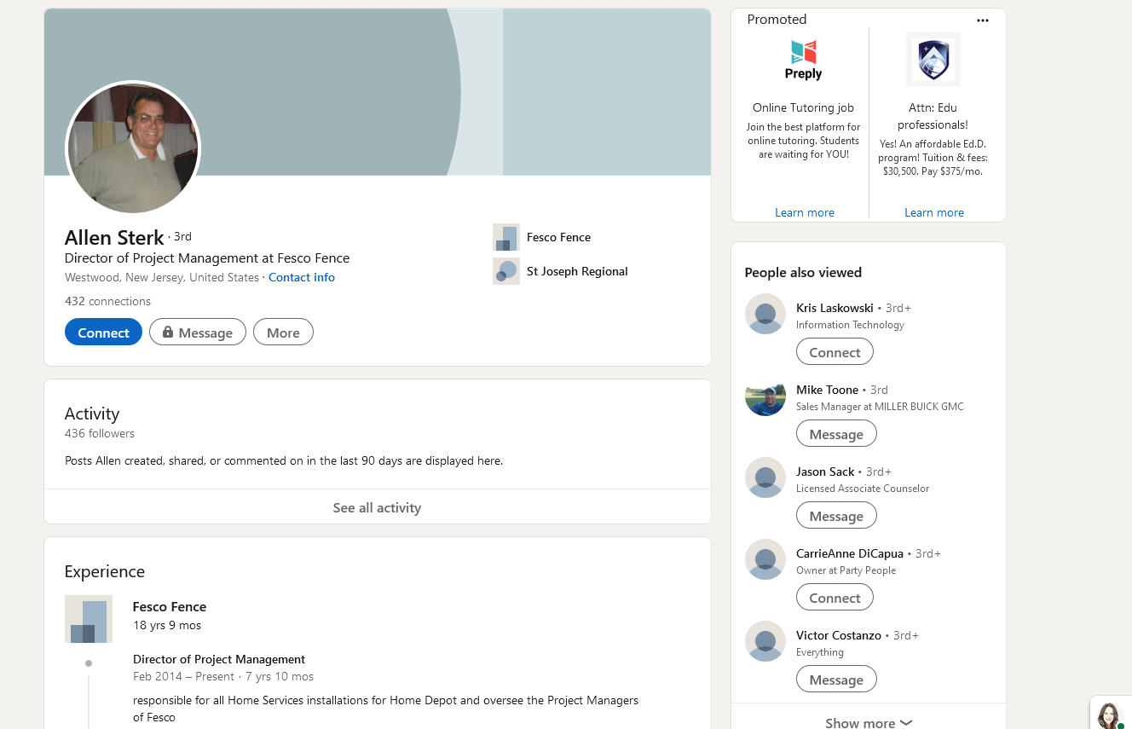

Slide 20
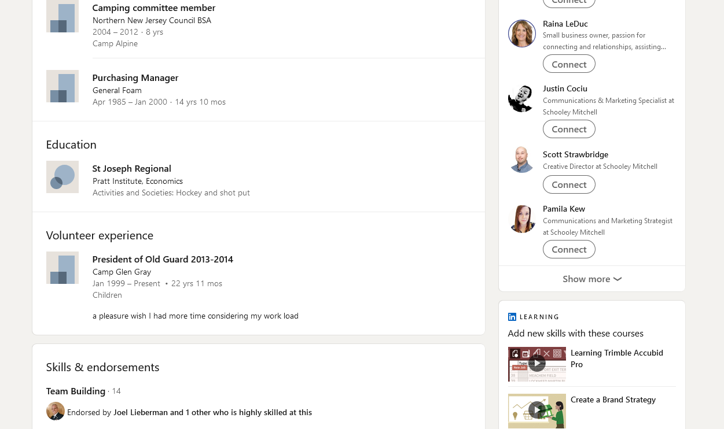


Slide 21
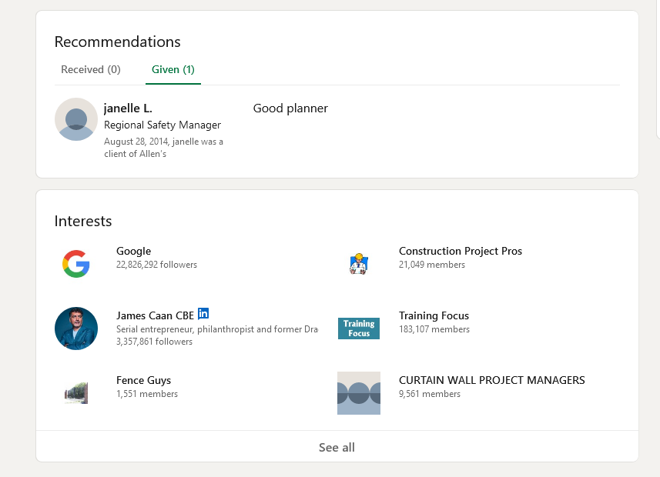
Ready…Set…GROW!

Slide 22
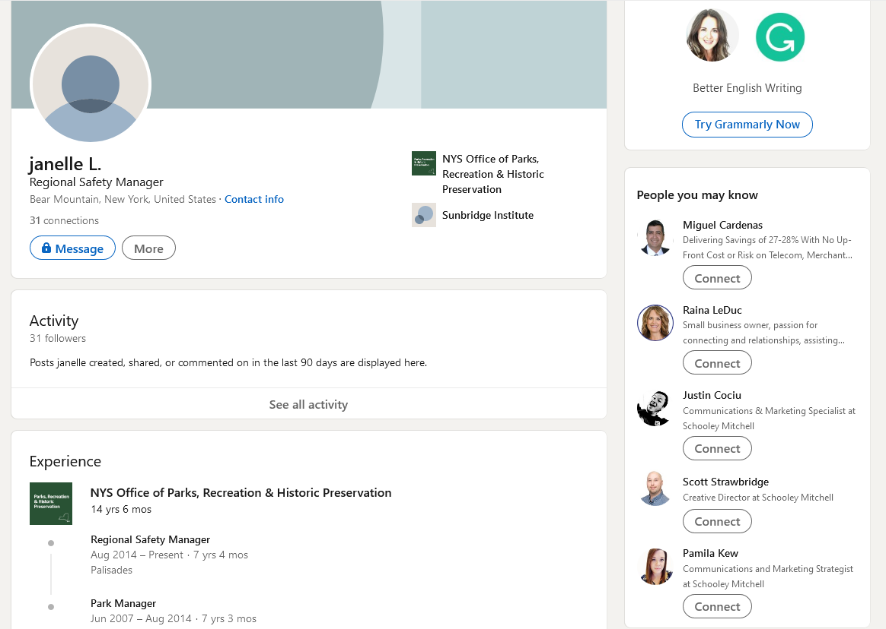


Slide 23

Activity Time
Ready…Set…GROW!

Slide 24
Specific?
Criteria
Location
Industry
Company
Name of Person
Specific Ask
Ready…Set…GROW!

Slide 25


Clients- Specific Asks
When to go back to the client?
Analysis
Value Report
Testimonial
Implementation Verification
Post Audit report
Who to ask for?
Suppliers
Customers
Testimonial
Ready…Set…GROW!

Slide 26
Referral Partners- Specific Asks
Be Strategic
Come with ASKS
Tell them how you’d like the introduction to happen
Email
In person
Phone call/zoom
Create a strategy for reaching out
Set a follow up meeting(s)/ on-going meetings
Warehouse > Libraries > Sales & Marketing > Paid Referrals
Ready…Set…GROW!

Slide 28



Key Takeaways
Do the Research
Pick 2-3 Companies/Individuals
Lean on the key Components
Ready…Set…GROW!

Slide 29

I want YOU to be SPECIFIC!
Ready…Set…GROW!

Slide 30


