Slide 1


Warehouse Updates and Refresher
Jessica Thom & Greg Kelly

Slide 2


The Warehouse
Thank you
Ready…Set…GROW!

Slide 3
The Warehouse
Sales tools
Production Tracking
CRM – contacts and prospect management
Telecom Tools
Ready…Set…GROW!

Slide 4
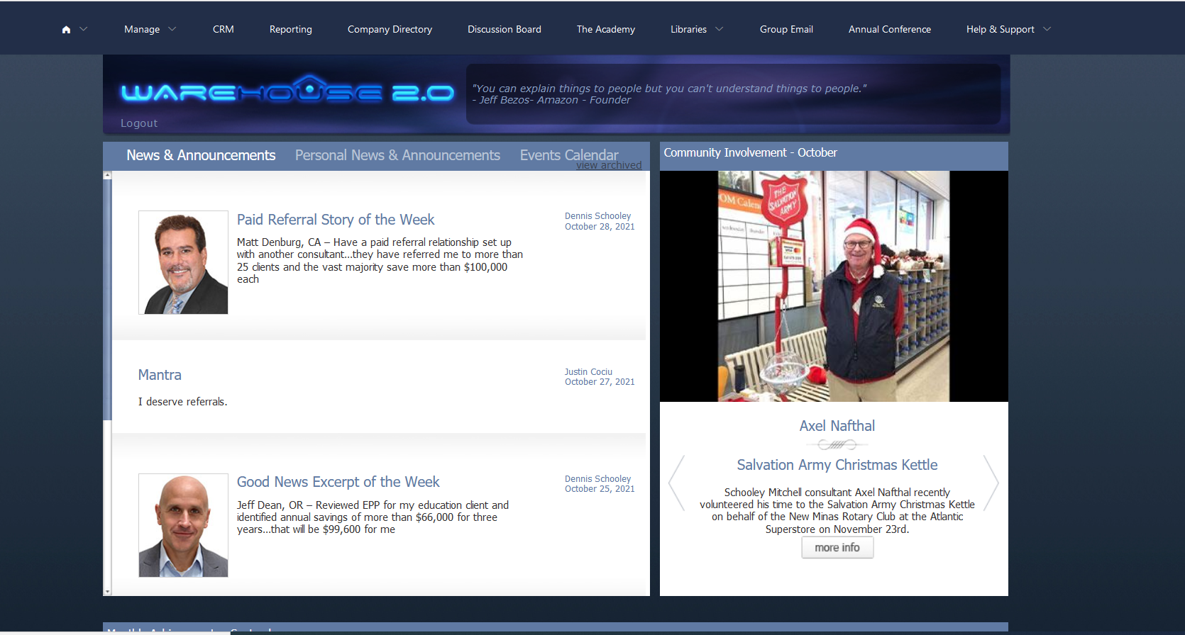
The Warehouse
Ready…Set…GROW!

Slide 5
The Warehouse
Drip Marketing
Ready…Set…GROW!

Slide 6
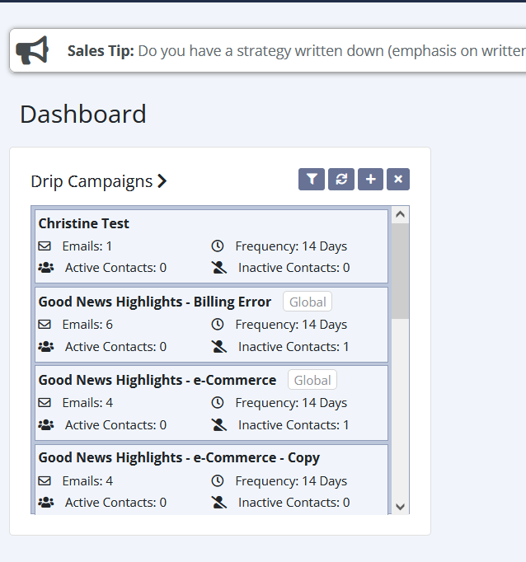
Drip
Libraries>Sales & Marketing>Webinars>2021 - New Drip Campaign Platform and Social Media Updates
Ready…Set…GROW!

Slide 7
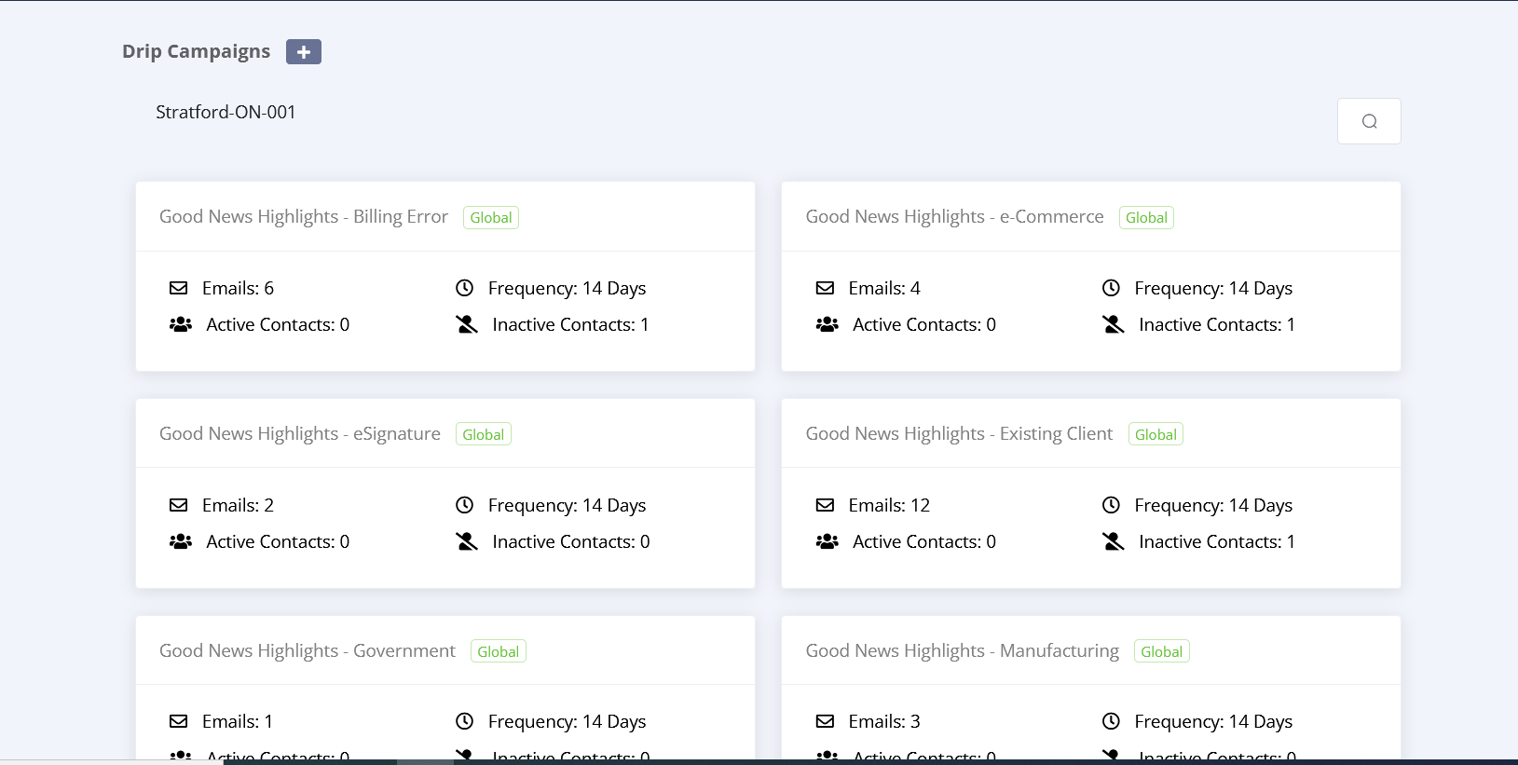
Drip
Ready…Set…GROW!

Slide 8
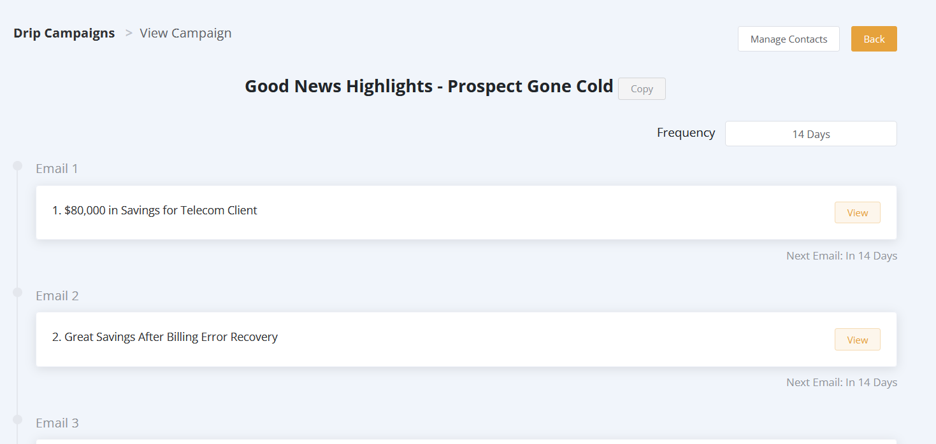
Drip
Ready…Set…GROW!

Slide 9
Drip
Ready…Set…GROW!

Slide 10
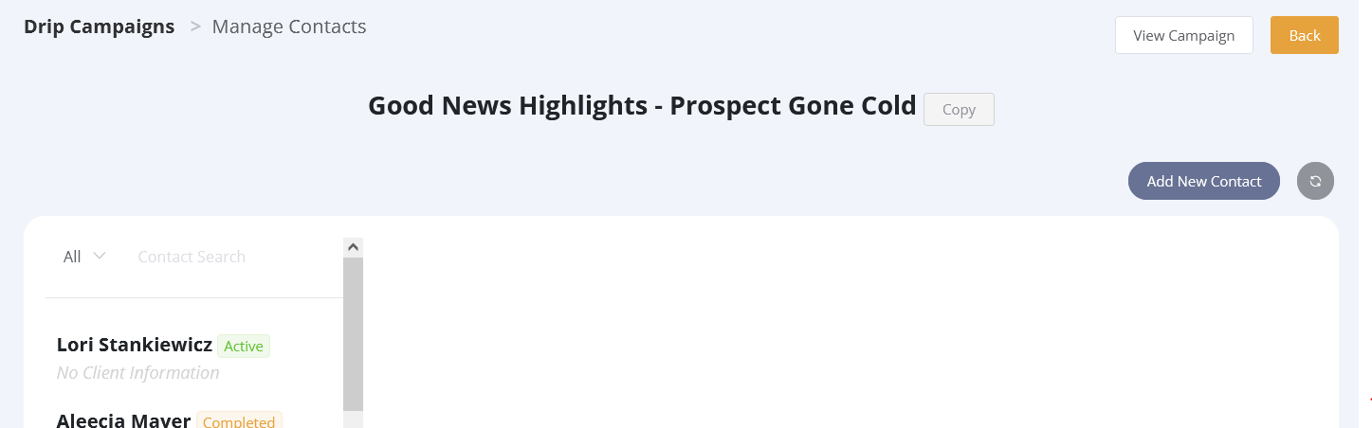
Drip
Ready…Set…GROW!

Slide 11
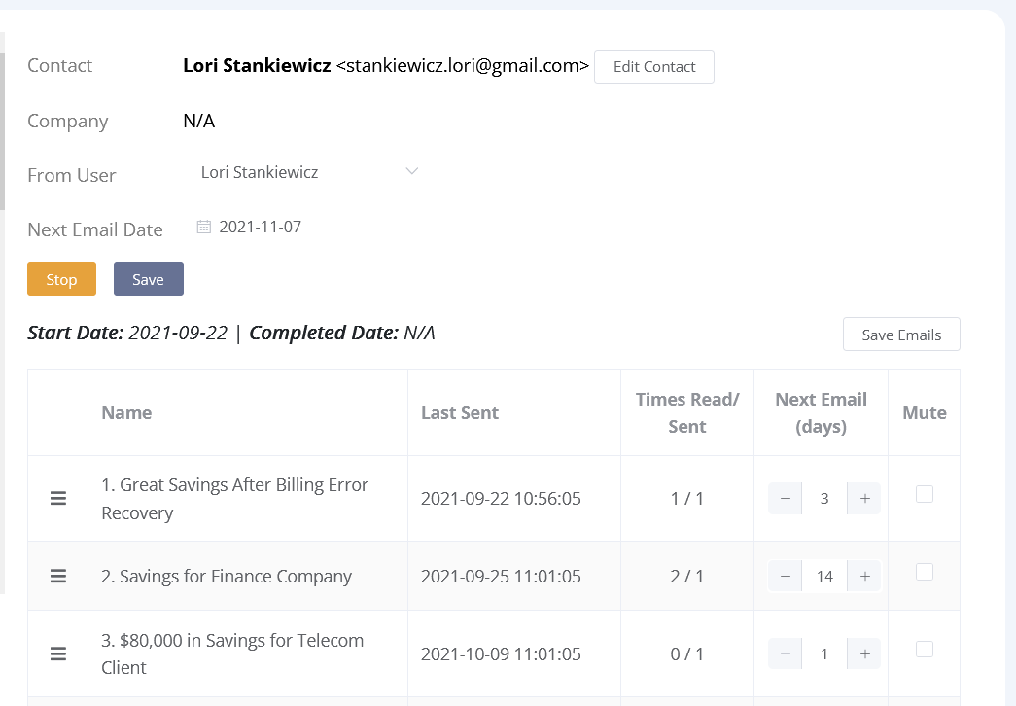
Drip
Ready…Set…GROW!

Slide 12
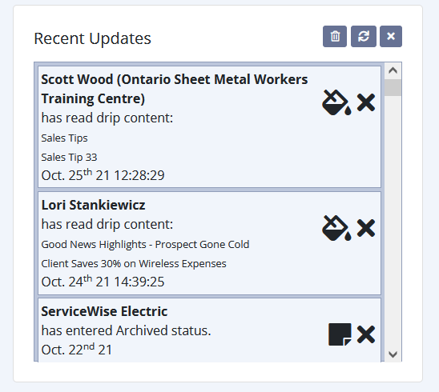
Drip
Ready…Set…GROW!

Slide 13
Drip
Updated Content
eSignature – 2 new emails
Government – 2 new emails
Medical – 3 new emails
Manufacturing – 2 new emails
Trades – 3 new emails
Misc. Services – 2 new emails
Ready…Set…GROW!

Slide 14
Drip
New Campaigns
Four Currencies
Value of Ongoing Support
Ready…Set…GROW!

Slide 15
Group Email
Group Email
Ready…Set…GROW!

Slide 16
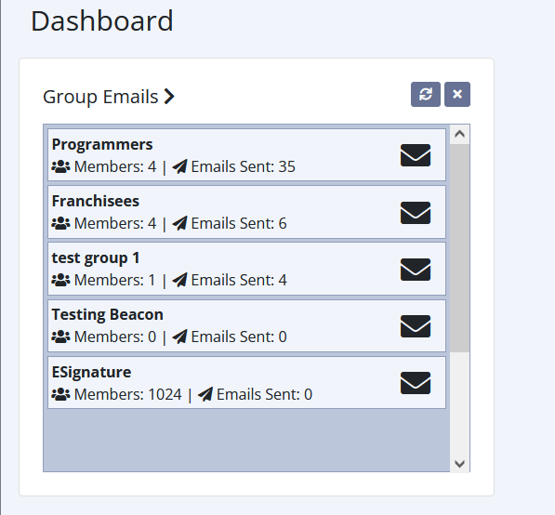
Group Email
Ready…Set…GROW!

Slide 17
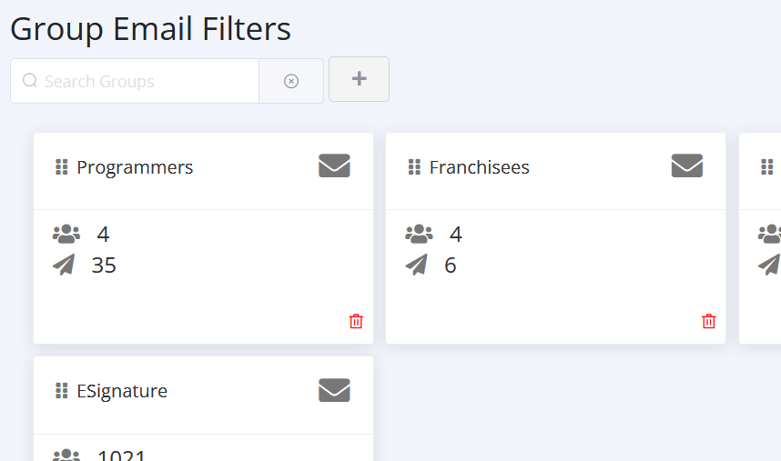
Group Email
Ready…Set…GROW!

Slide 18
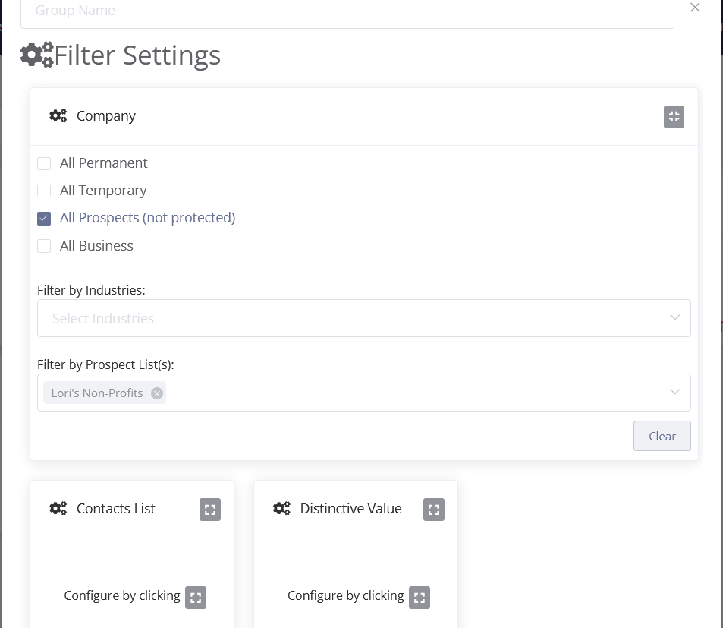
Group Email
Ready…Set…GROW!

Slide 19
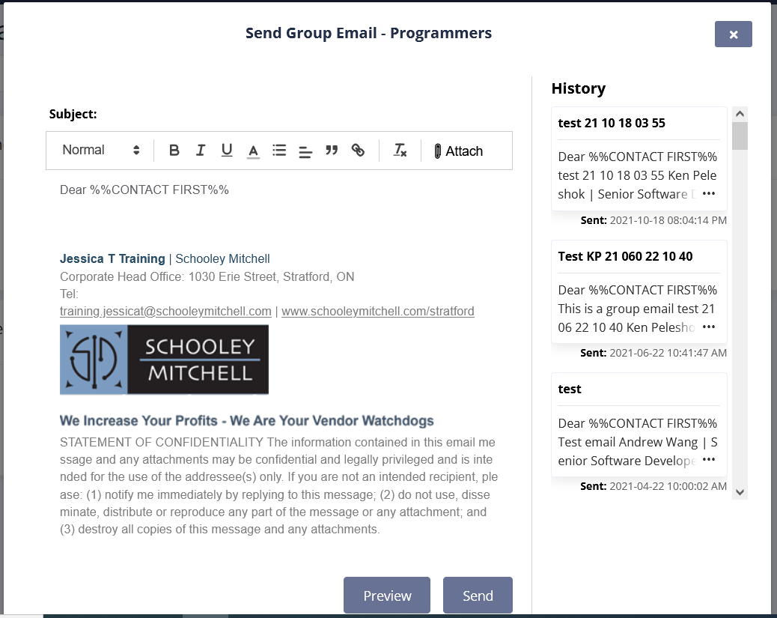
Group Email
Ready…Set…GROW!

Slide 20
The Warehouse
Production Tracking
Ready…Set…GROW!

Slide 21
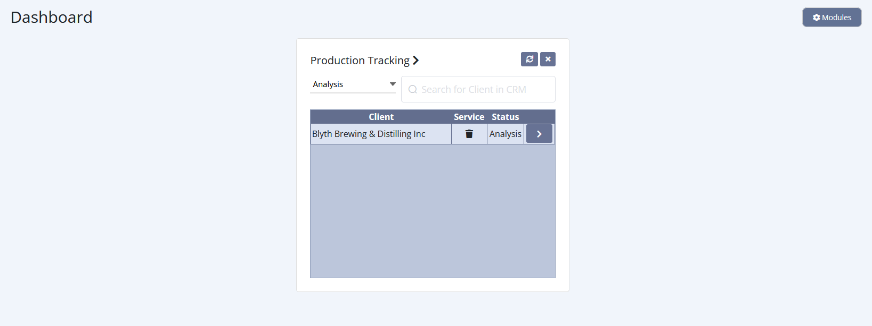
Production Tracking
Ready…Set…GROW!

Slide 22
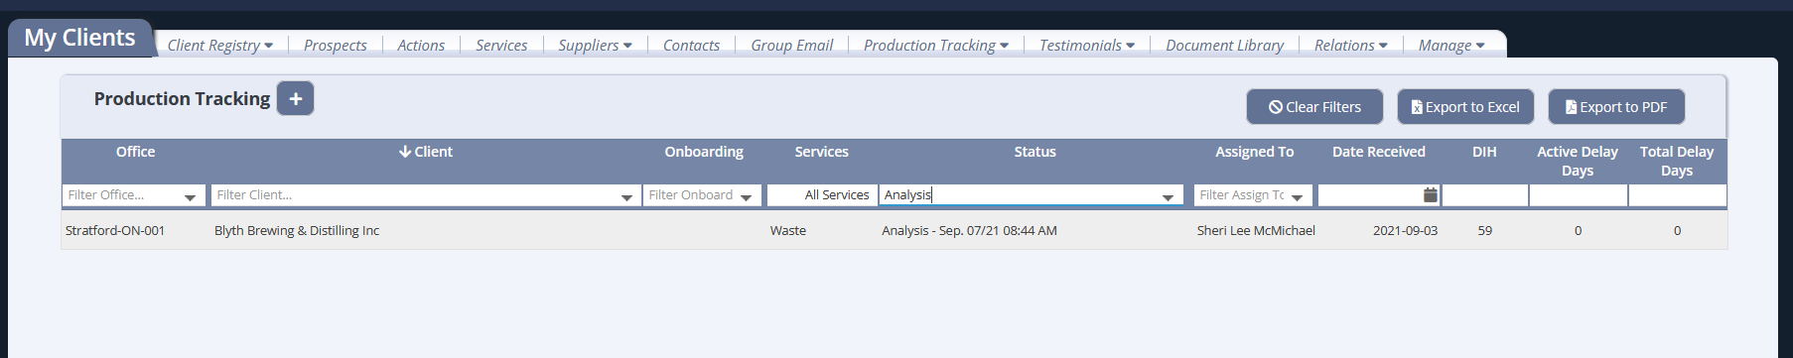
Production Tracking
Ready…Set…GROW!

Slide 23
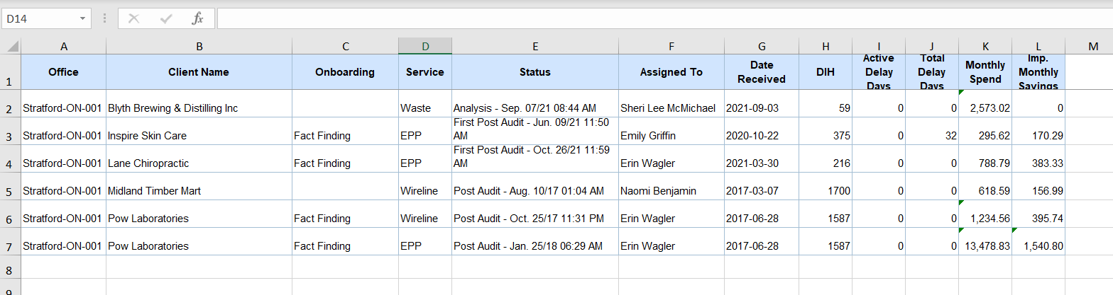
Production Tracking
Ready…Set…GROW!

Slide 24
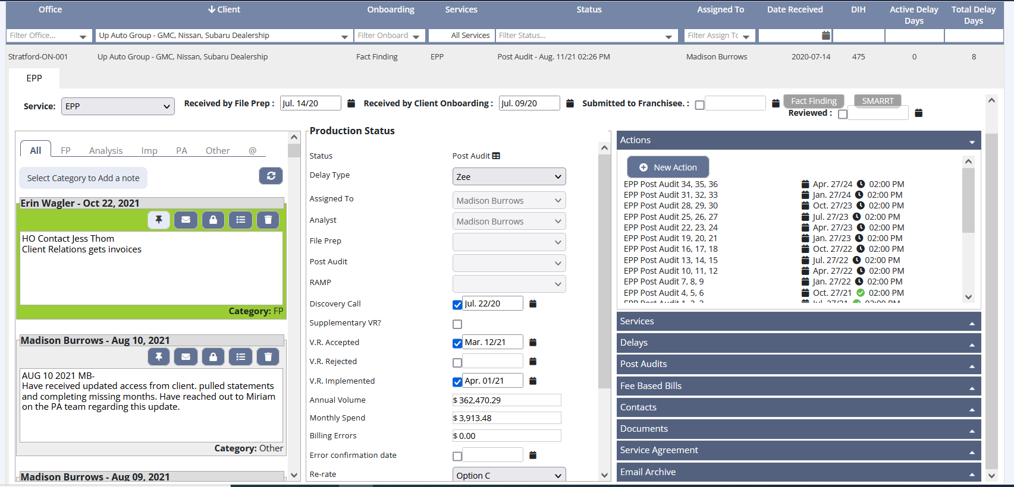
Production Tracking
Ready…Set…GROW!

Slide 25
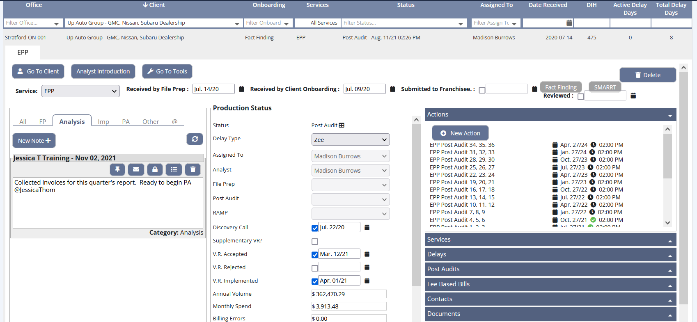
Production Tracking
Ready…Set…GROW!

Slide 26
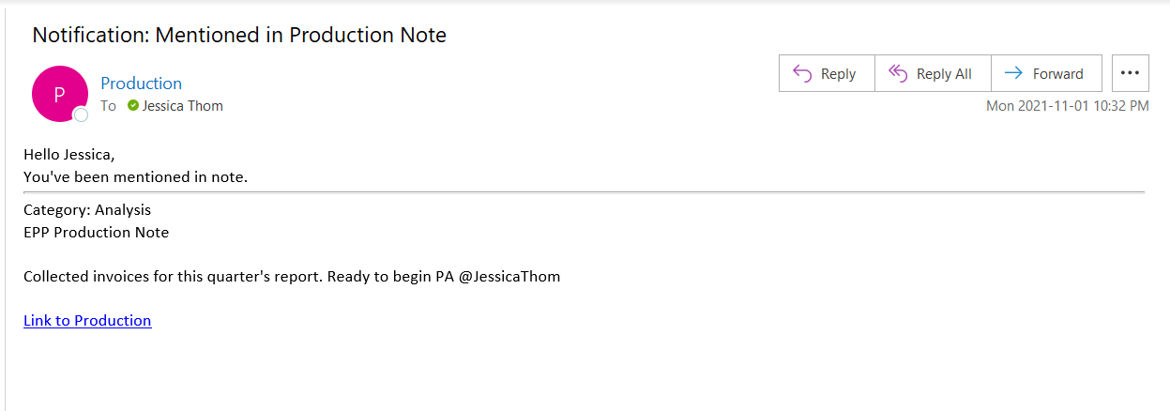
Production Tracking
Ready…Set…GROW!

Slide 27
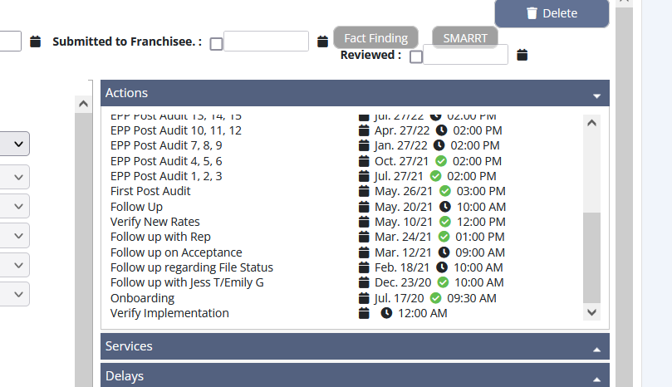
Production Tracking
Ready…Set…GROW!

Slide 28
The Warehouse
Production Tracking
New Reports
Ready…Set…GROW!

Slide 29
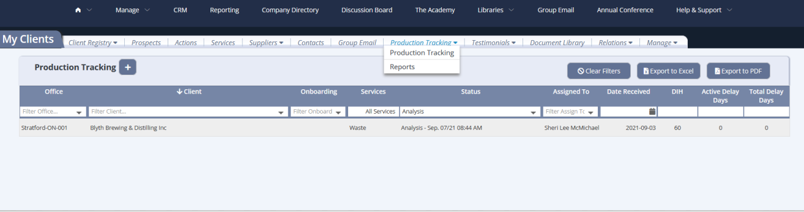
Production Tracking
Ready…Set…GROW!

Slide 30
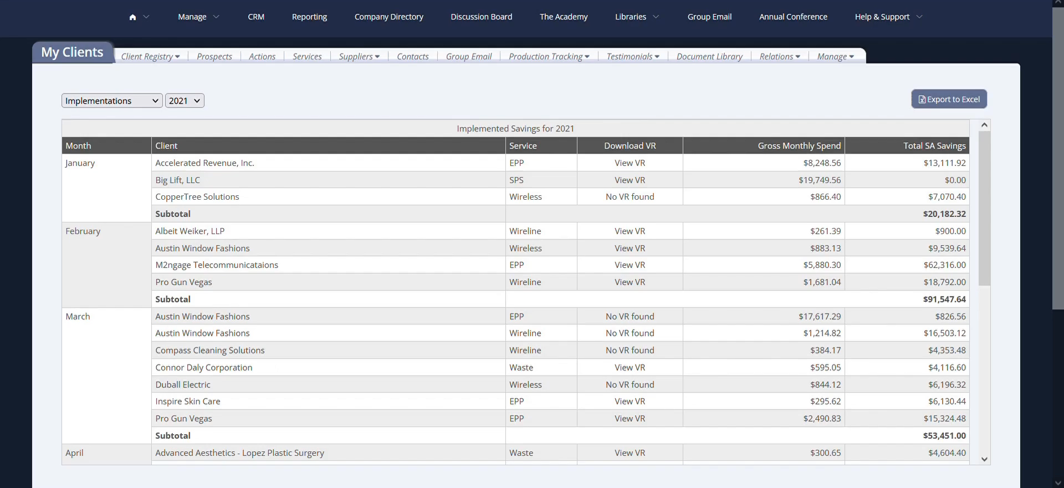
Production Tracking
Ready…Set…GROW!

Slide 31
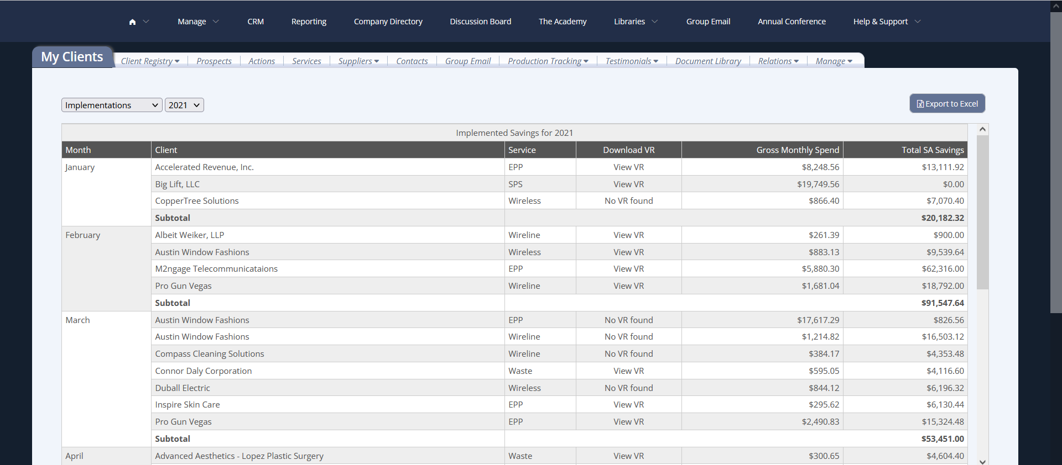
Production Tracking
Ready…Set…GROW!

Slide 32
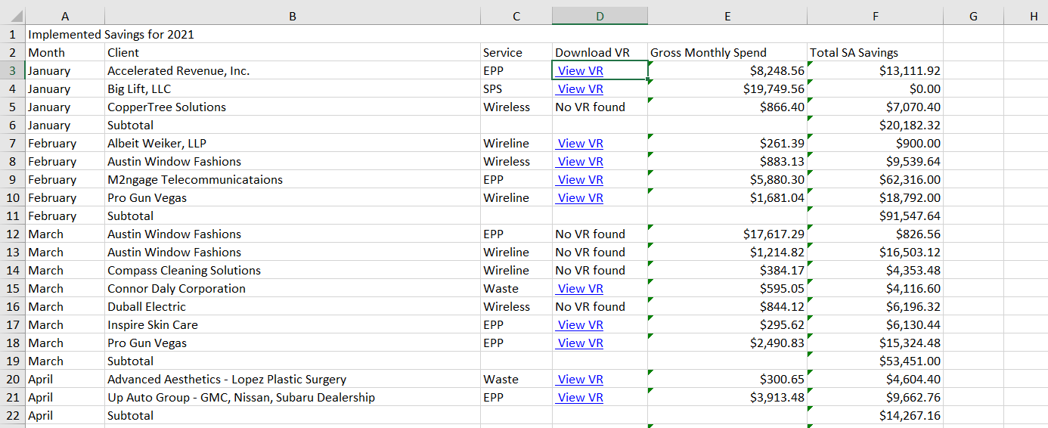
Production Tracking
Ready…Set…GROW!

Slide 33
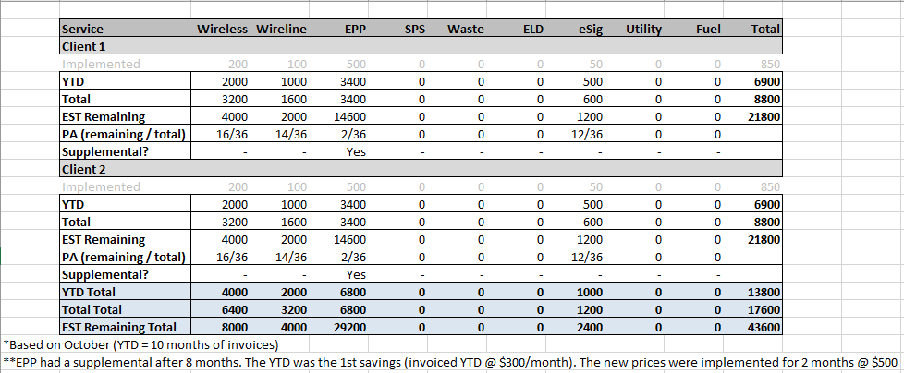
Production Tracking
Ready…Set…GROW!

Slide 34
The Warehouse
eSignature
Ready…Set…GROW!

Slide 35
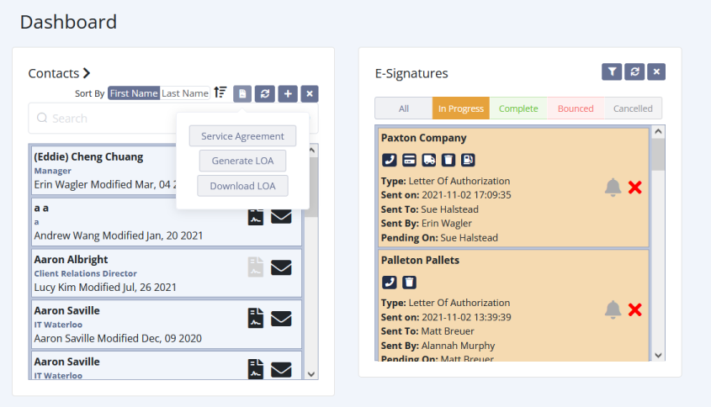
eSignature
Ready…Set…GROW!

Slide 36
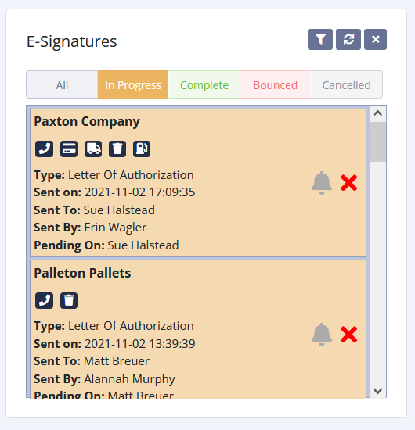
eSignature
Ready…Set…GROW!

Slide 37
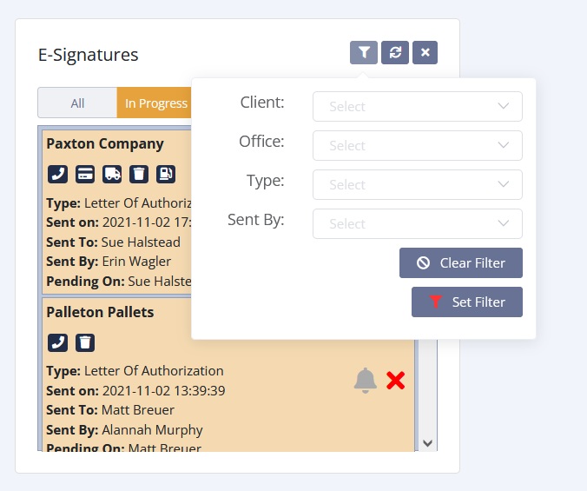
eSignature
Ready…Set…GROW!

Slide 38
eSignature
Ready…Set…GROW!

Slide 39
The Warehouse
eSignature
HO Prod Agreement
Ready…Set…GROW!

Slide 40
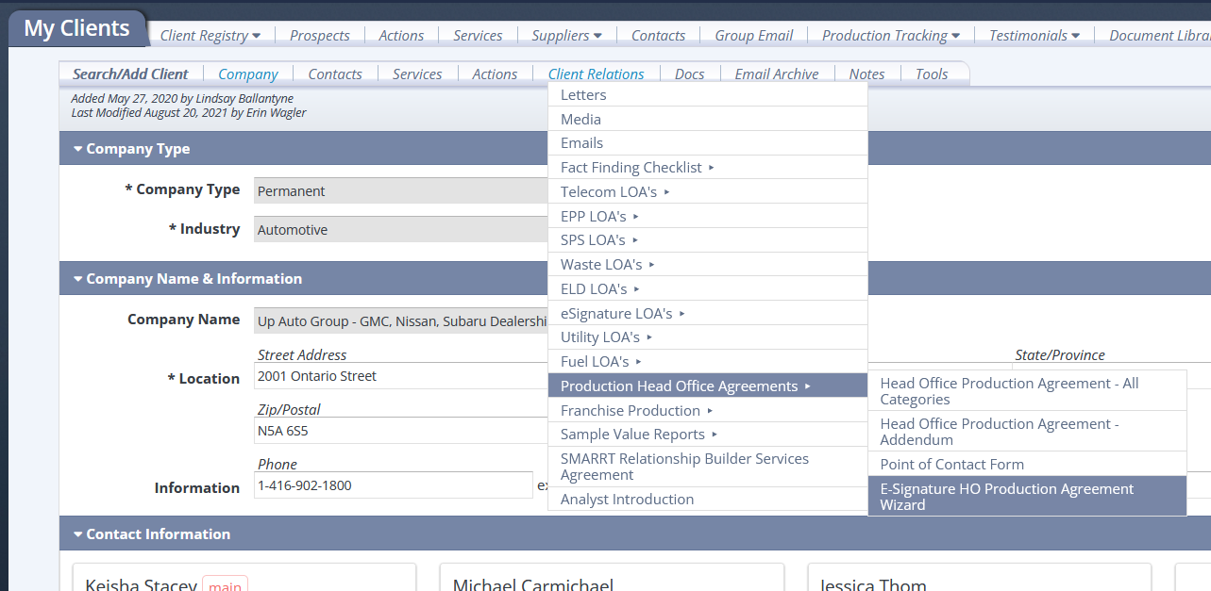
eSignature
Ready…Set…GROW!

Slide 41
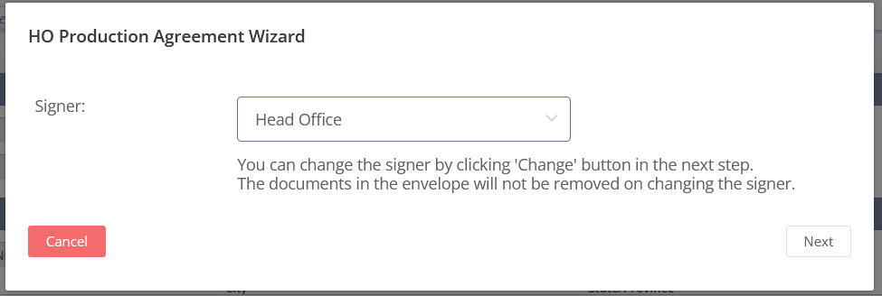
eSignature
Ready…Set…GROW!

Slide 42
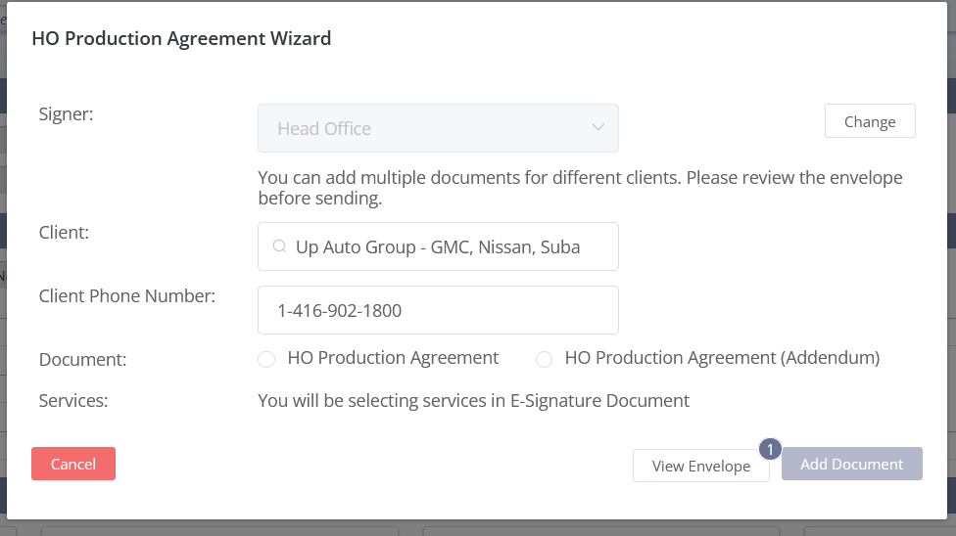
eSignature
Ready…Set…GROW!

Slide 43
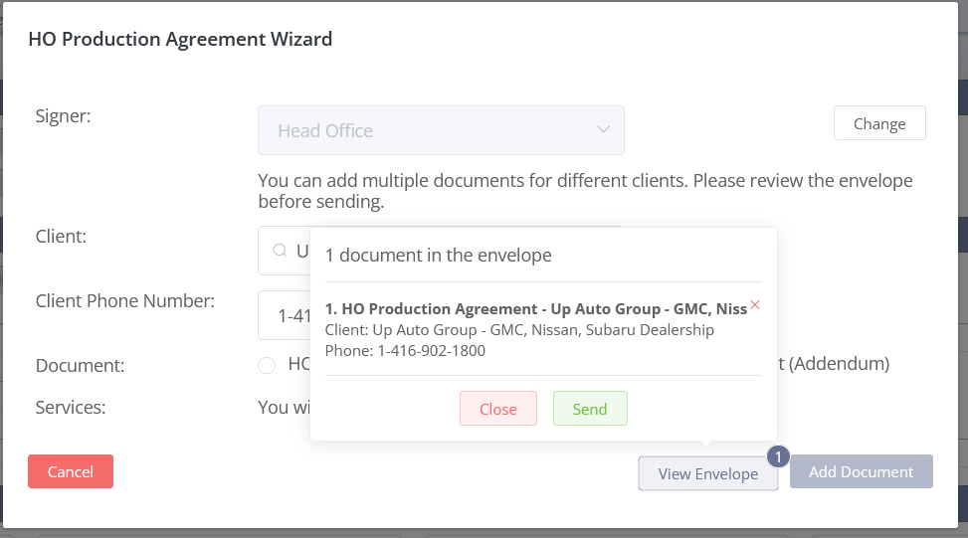
eSignature
Ready…Set…GROW!

Slide 44
The Warehouse
Support Requests
Ready…Set…GROW!

Slide 45
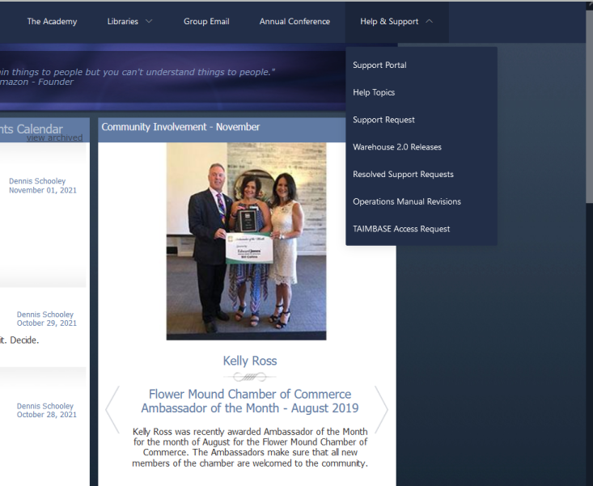
Support Portal
Ready…Set…GROW!

Slide 46
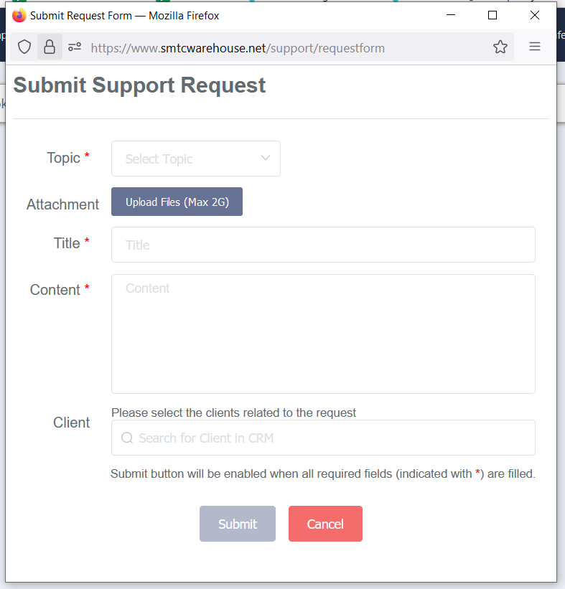
Support Portal
Ready…Set…GROW!

Slide 47
Support Portal
Ready…Set…GROW!

Slide 48
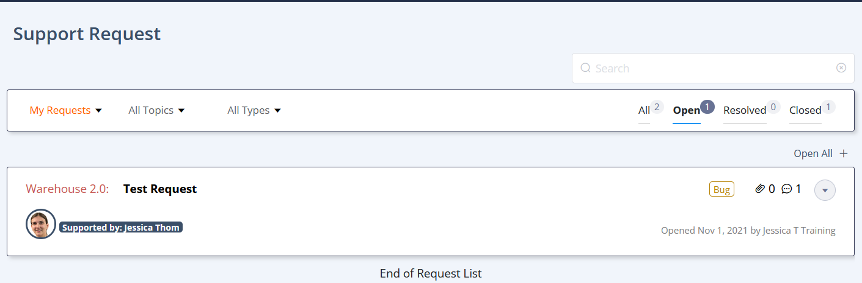
Support Portal
Ready…Set…GROW!

Slide 49
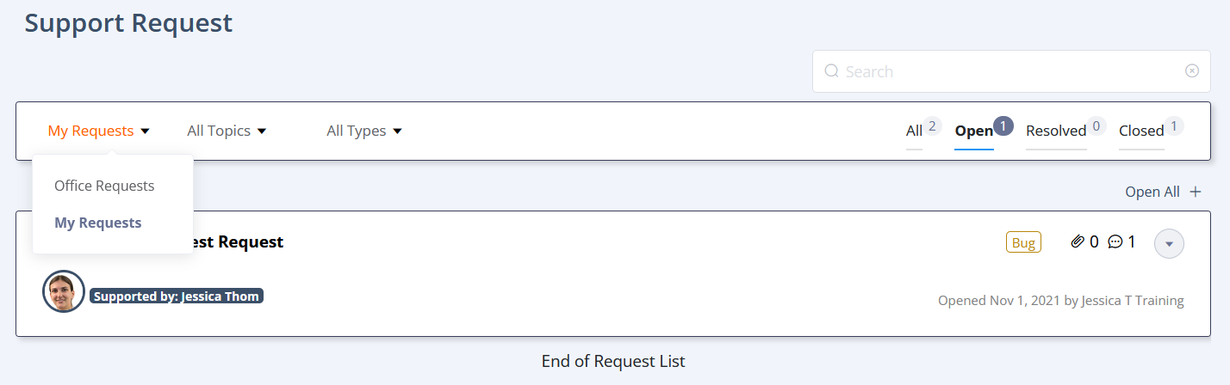
Support Portal
Ready…Set…GROW!

Slide 50
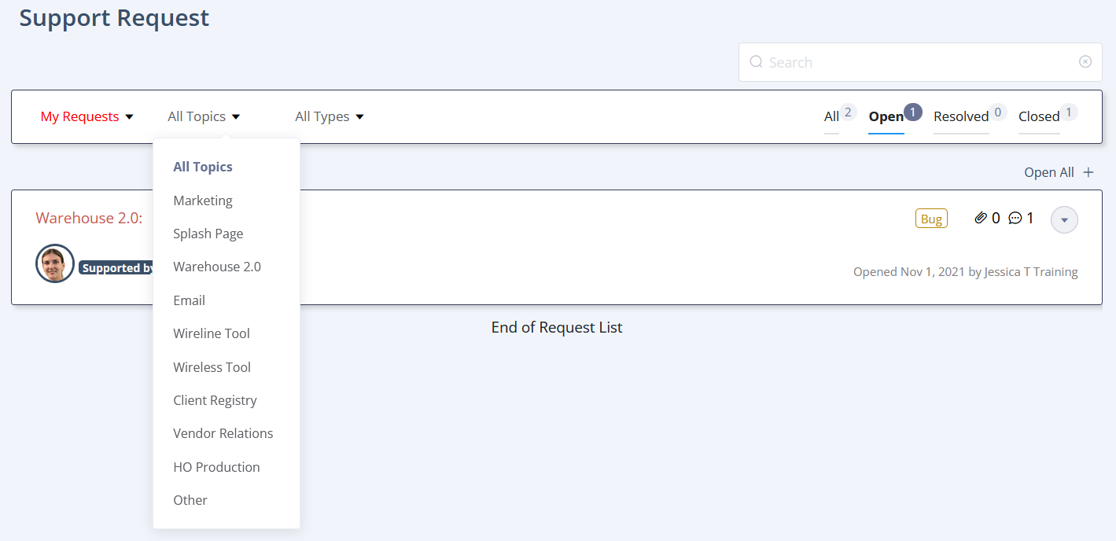
Support Portal
Ready…Set…GROW!

Slide 51
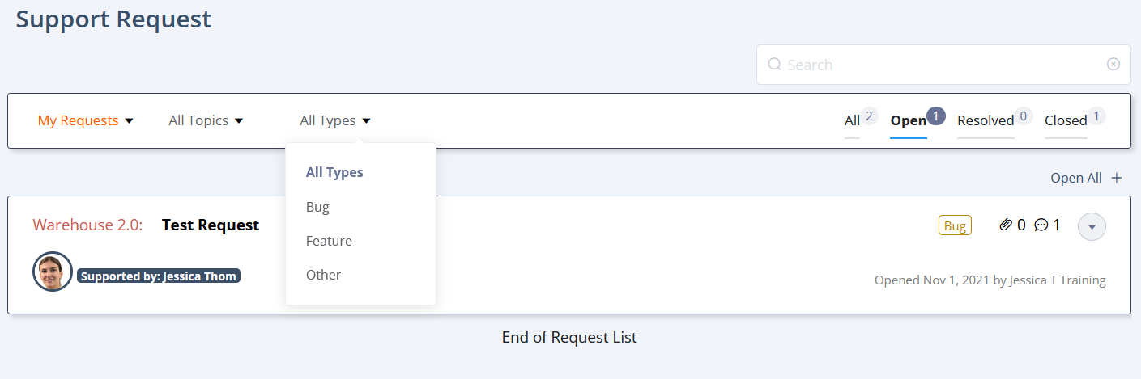
Support Portal
Ready…Set…GROW!

Slide 52
Support Portal
Ready…Set…GROW!

Slide 53
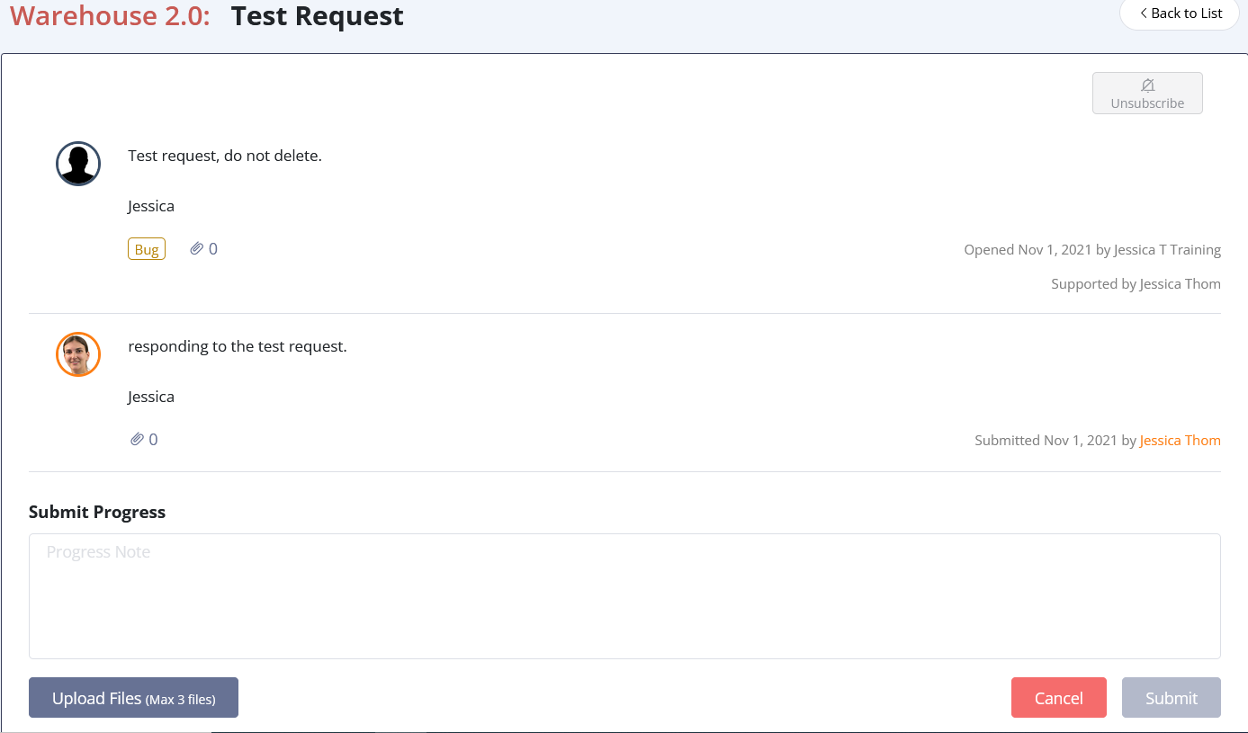
Support Portal
Ready…Set…GROW!

Slide 54
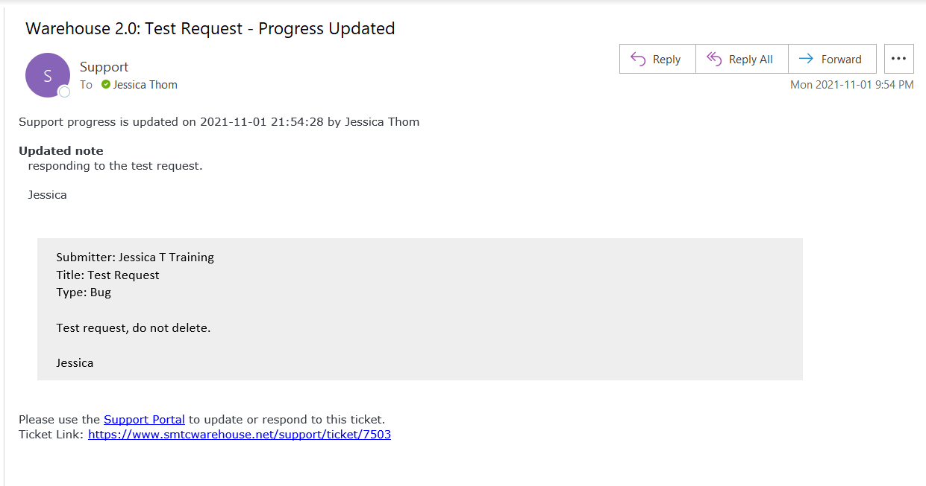
Support Portal
Ready…Set…GROW!

Slide 55
Contacts
And….
What you’ve all been waiting for…
Ready…Set…GROW!

Slide 56
Contacts
Contacts
Ready…Set…GROW!

Slide 57
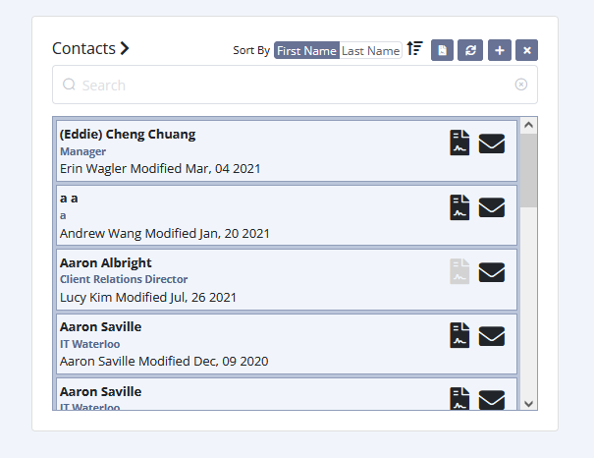
Contacts
Ready…Set…GROW!

Slide 58
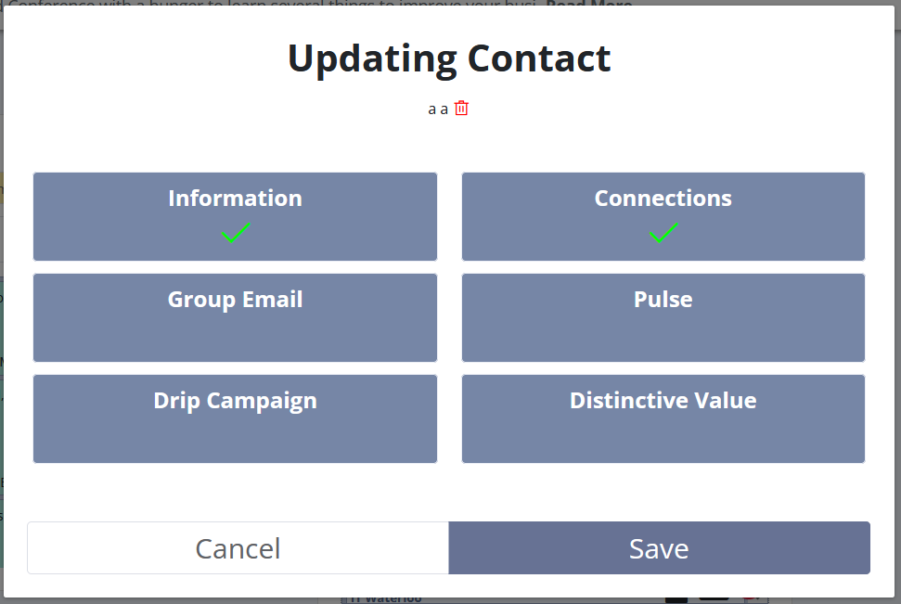
Contacts
Ready…Set…GROW!

Slide 59
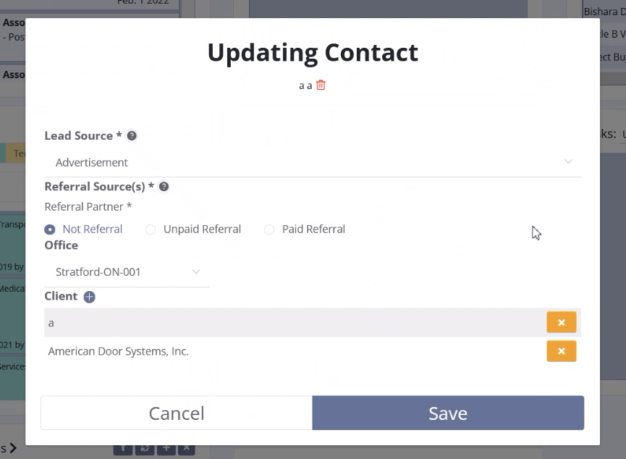
Contacts
Ready…Set…GROW!

Slide 60
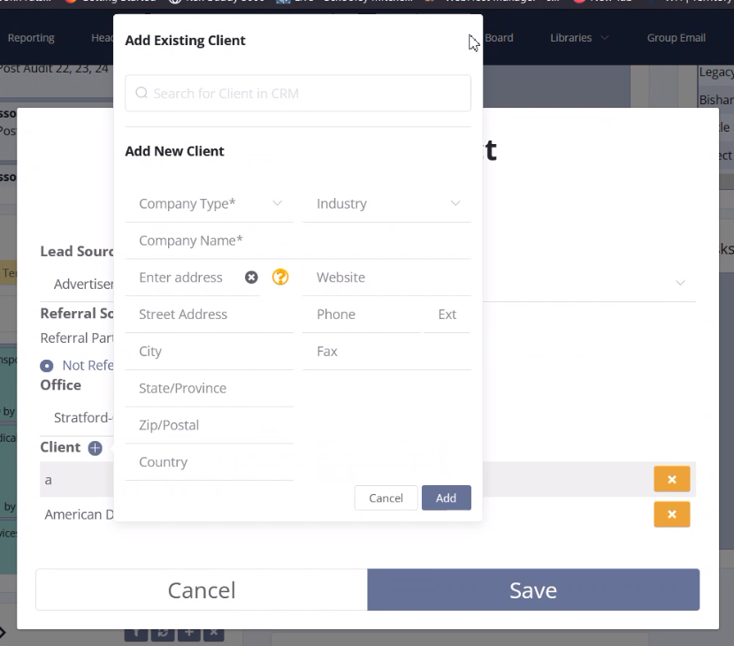
Contacts
Ready…Set…GROW!

Slide 61
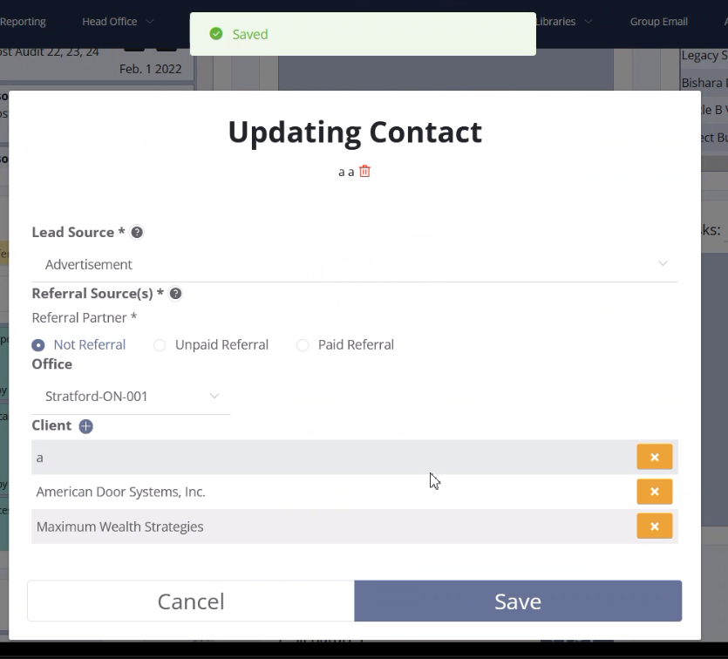
Contacts
Ready…Set…GROW!

Slide 62
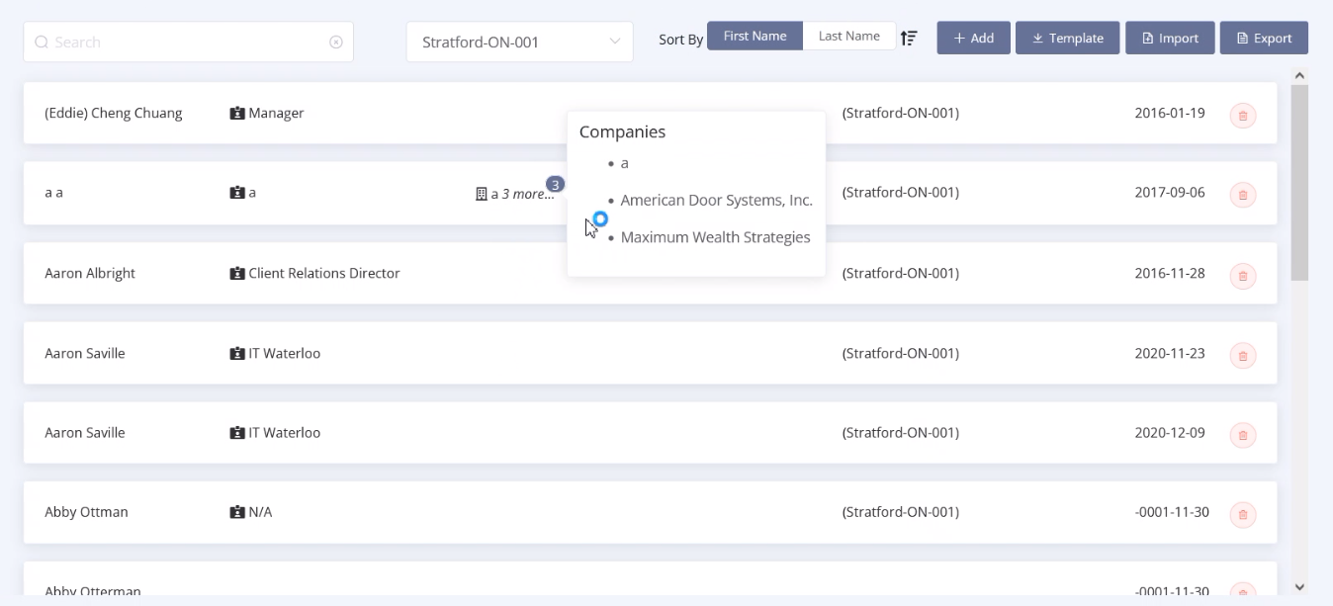
Contacts
Ready…Set…GROW!

Slide 63
Other Updates
Tools
Imports now processed in the background so you can continue your work without locking up the browser, affects large imports
Improved error reporting and handling
Continuously improving tools parser, major updates to Verizon and Rogers Personal bill parsers
Ready…Set…GROW!

Slide 64
Other Updates
Add-to-WIP
Updated to work with Macs and Office365 Web
Reporting
Production Report - default collected button
Ready…Set…GROW!

Slide 65
Coming Up
Tools
More reports to optimize and manage large data
Production Tracking
Reports to manage financial projections
Tracking Post Audits
Dashboard
Notification Center
Ready…Set…GROW!

Slide 66

Jessica Thom
&
Greg Kelly

